Slide 1
Unit 2
Aztecs, Mayan, and Inca Civilizations
Research and Presentation Skills

Slide 2
Day 1

Slide 3
Starter
How can you determine if a source is reliable or not?

Slide 4
Think pair share: What kinds of sources should you use when completing an assignment [or working on a project]?

Slide 5
Example A
In this article, I will explain how people can get taller. There are many short people who have been told by their doctors that they have completed their growth spurt years and that they no longer will continue to achieve additional height. These doctors certainly have misinformed their patients, and as a result have discouraged them. Instead, they should tell them that if patients were to hang upside down for 10 minutes every 4 hours, they will stretch their spinal columns. If these short people follow this routine for one full month, they can increase their height two full inches and stand shoulder to shoulder with peers their age. The medical research about spinal stretching spans many decades and have been attributed to the success of many basketball players who sought to increase their height beginning in their middle school years.
Notes:
Like English or math, Google Search has particular operators that modify a search query.
Tell students they will be introduced to seven advanced operators to use in their searches.

Slide 6
Example B
All football players are angry, vicious people who use the football field to express their anxiety. It has been reported that this sport draws males who are inherently distressed individuals who seek this activity as a means to blow off steam. The following was reported in the magazine Sports and Mental Health, “Everyone who plays this sport, even from a young age, has issues relating to anger management. This has been a pervasive problem that management of national teams must address head on.” Unless football coaches and officials take this issue seriously and recruit players who are more emotionally stable, our society might incur problems. For example, some players visit bars and begin fights with patrons. Others engage in violent activities like dog fighting and breeding pit bulls.
Notes:
Like English or math, Google Search has particular operators that modify a search query.
Tell students they will be introduced to seven advanced operators to use in their searches.

Slide 7
Which of the examples – A or B – seems too good to be true?
(Answer: A)
Beware of this type of writing as it can indicate unreliability and inaccuracy.
What’s the matter with B?

Slide 8
Types of Website Formats
Each group gets a set of screenshots from various web pages. Lay out your set of print-outs that represent a compilation of different formats. Categorize using these questions to guide the activity:
What is included in this webpage?
How is this webpage like another one?
Which pages can I group together?
Do I know a name for this type of web page?

Slide 9
Discuss Findings
What do you notice about this collection of similar web pages?
What are characteristics that describe this collection?
What type of web page is this?
Distribute “Formats of Web Pages”

Slide 10
Reorganize pages correctly

Slide 11
Why Different Formats?
Why do people access different types of web pages?
What is the purpose for each format of web page?
What type of evidence can searchers anticipate getting from these different formats?
How can searchers find these web pages? What do you see that is searchable about them?

Slide 12
Ancient Civilizations
What civilizations can you think of that existed in Latin America?
Aztec Civilization
Maya Civilization
Inca Civilization

Slide 13
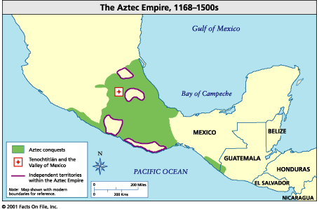
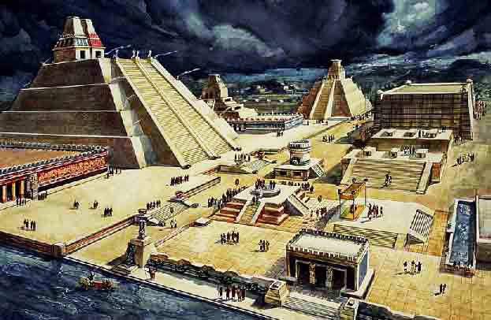
Aztec Empire
Location: Lower Mexico
Years: 1100 AD -1521 AD
Capital City: Tenochtitlan

Slide 14
Top 25 Things about the Aztecs
List three things down in your notes that you learn from the video

Slide 15
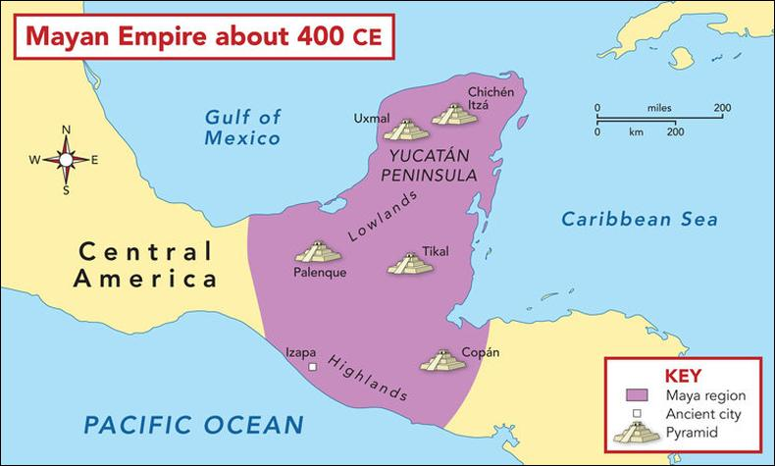
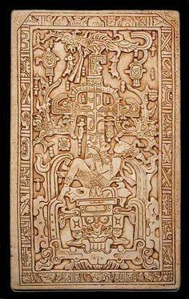
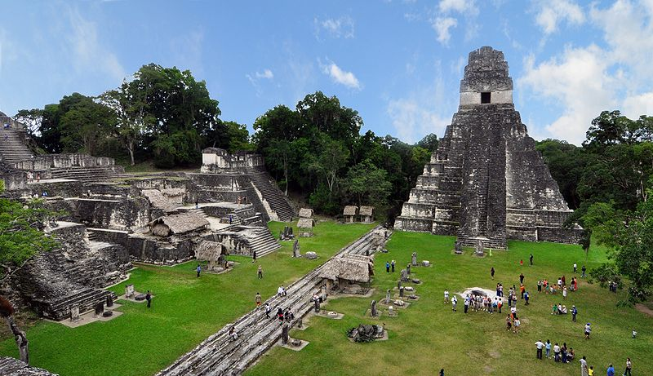
Maya Empire
Location: Guatemala
Years: First sign of Maya people in 2000 BC-- Conquered by Spanish Conquistadors in 1517, Maya civilization still heavily populates Guatemala today
Main cities: TIkal, Copan, Palenque, Chichen Itza,

Slide 16
Top 25 Things about the Maya
Write down three things in your notes that you find interesting.

Slide 17
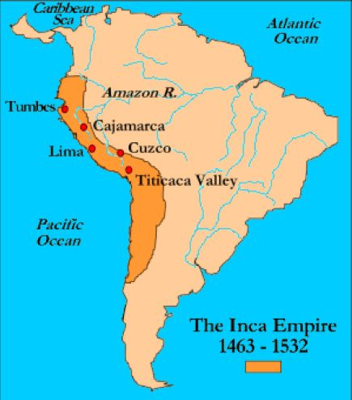
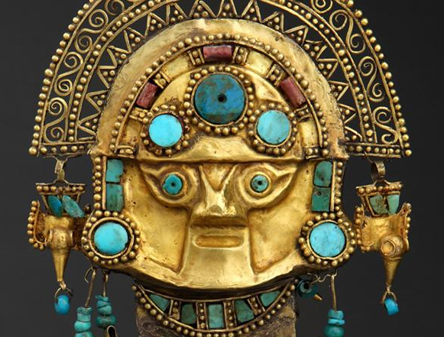
Inca Empire
Location: Western Coast of South America, covers mostly Peru and Chili
Years: Pre-Inca Empire 2500 BC to 1200 AD, Inca Empire 1200 AD to 1572 AD
Main Cities: Cuzco, Machu Pichu

Slide 18
Top 25 Things about the Incas
Write down three things in your notes that you find interesting.

Slide 19
Machu Pichu -
Sits 8,000 feet above sea level atop the Andes Mountain range in southern Peru.
Considered the Lost Incan City because it wasn’t discovered until 1911

Slide 20
Ender

Slide 21
Day 2

Slide 22
Starter
Describe 3 interesting facts you remember about the Aztec, Maya, and Inca Empires. ( 3 interesting facts about each)

Slide 23
Quiz (for classes taught on Thursday)
Name one format of web page that is excellent for research in this class.
Name a format that is not excellent (BAD) for research in this class.
Describe one way to validate your sources.
Why do we source our work?

Slide 24
why we cite sources

Slide 25
Why is citation important?
To show your reader (teacher) you have done proper research.
To give credit to other researchers and scholars who have put in a lot of hard work to give you easy information!
To avoid plagiarism! Always cite when you use quotation marks, or even when you are summarizing information.
An exception to this is when the information is agreed to be “common sense.”
To allow your reader (teacher) to track down the sources you used.

Slide 26
Is there an easier way!?
You don’t have to memorize every boring rule….. yet. (save that for university)
For now, you can use helpful websites designed for students!
http://www.bibme.org/
http://www.citationmachine.net/
Many more!

Slide 27
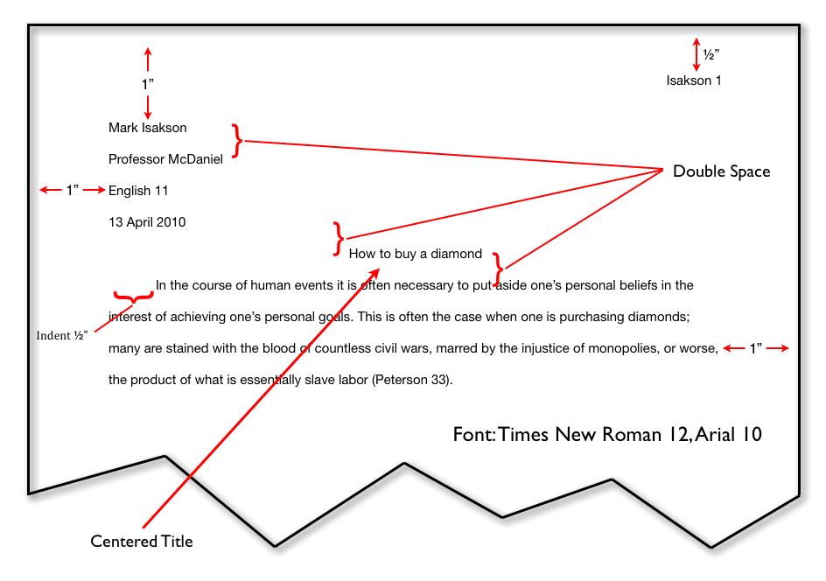
What should your paper look like in MLA formatting?
When in doubt, check it out: https://owl.english.purdue.edu/owl/resource/747/01/

Slide 28
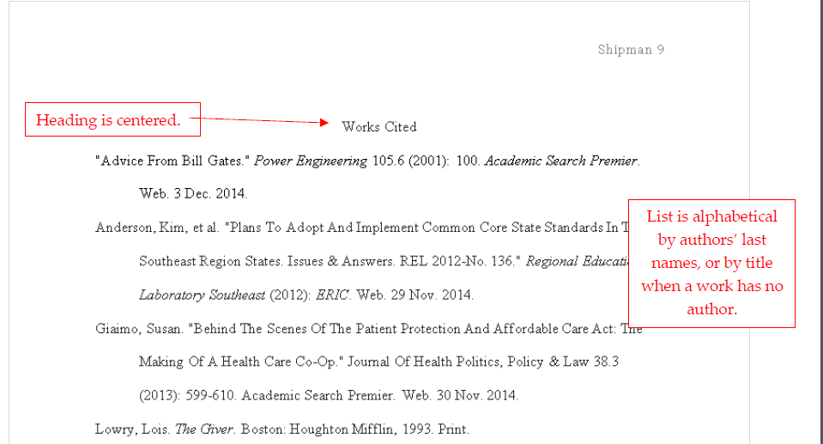
What should your works cited page look like in MLA formatting?
When in doubt, check it out: https://owl.english.purdue.edu/owl/resource/747/01/

Slide 29
Ender

Slide 30
Day 3

Slide 31
Starter
What are some of the sources you have been using in your research so far?
What is the most interesting thing you have learned in your research so far?

Slide 32
Quiz (for classes taught on Friday)
Name one format of web page that is excellent for research in this class.
Name a format that is not excellent (BAD) for research in this class.
Describe one way to validate your sources.
Why do we source our work?

Slide 33
Steps to Analyzing Visuals
Identify the subject and determine the medium that is being used.
Visuals can be a photograph, a piece of fine art, an advertisement, or a cartoon. The type of visual being used can help you determine the audience.
Identify the credit line and title.
The credit line tells you who created the image and the title can give you clues as to what the artist intended the image to show
Examine the details and the way in which the subject is depicted
The details in the visual that surround the main subject can help you determine how the subject is depicted and what the artist wants you to know about the subject
Place the image in a historical context
The time frame in which the image was created gives you an idea of what the artist’s possible intentions were in creating the image. You can draw on your knowledge of that particular time period to help further your understanding of the image.

Slide 34
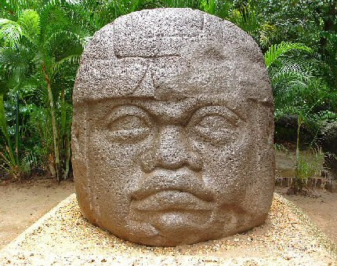
Olmec Colossal Head, La Venta, Mexico ~800 BC
Notes:
Olmec Colossal Head, La Venta Mexico
Made of Basalt Stone, about 10 feet tall and weighs about 20 tons; subject is an Olmec man’s head
Olmec Colossal Head, La Venta Mexico, ~800BC
The head appears to have some kind of helmet on; this could mean a couple of things: he is a warrior, it is a helmet that was worn in the ancient american ball game, or it is a symbol or royalty; the head is massive so the person it depicts must be very important
There is not much known about the Olmec’s so we are not entirely sure on the meaning behind these colossal heads. The Olmecs are the predecessors to the Maya, Aztec and Inca civilizations and so based on what we know about their desires of memoralizing their kings we can assume that the Olmecs probably were doing the same thing.

Slide 35
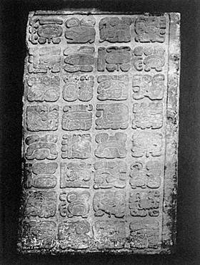
Lintel Carving Yaxchilan (Maya) ~600 AD
This is what Maya writing looked like
They were symbols similar to Egyptian Hieroglyphs
You can find their writing everywhere. In the artwork, on sides of buildings, on statues, etc.
Written records ensured that information would always be remembered, once something was carved it was given a spirit and lived forever
Notes:
Carved in stone and placed above a doorway (Lintel carving). The subject is Maya hieroglyphs.
Lintel Carving Yaxchilan (Maya) ~600 AD
Details: Many hieroglyphs look similar and therefore probably have similar meanings
The maya recorded everything and had a very extensive written language. They believed that once you had written something down you created that piece of writing giving it a spirit and that knowledge would exist for eternity.

Slide 36
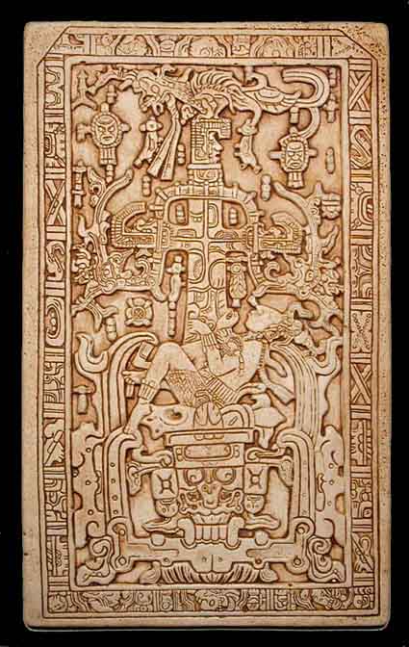
Sarcophagus lid of Pakal, Palenque ~600 AD
Depicts the World Tree which was a symbol of creation.
World Tree= Mortal World where creation takes place
Pakal and below= the underworld or Xibalba
Above World Tree= Heavens where the creator gods and your ancestors are located
Notes:
The man in the center is the King Pakal of Palenque. He is dead and falling into the underworld (Xibalba). The World Tree represents the mortal world, then above the tree is the heavens represented by a bird deity. So this image shows the three planes of existence in Maya religion: The heavens, mortal world, and underworld
Carved out of stone, the subject is of the King Pakal who has died
Sarcophagus lid of Pakal, Palenque ~600 AD
Man lying down below him is a monster mask (represents Xibalba), coming up from his body is a cross like tree (Maya World Tree/symbol of creation), and above that is a creature of some kind (a bird deity representing the creator gods and past ancestors)
This is a sarcophagus lid so it was created after the death of Pakal. It shows the three realms of existence in Maya religion and includes many other religious motifs

Slide 37
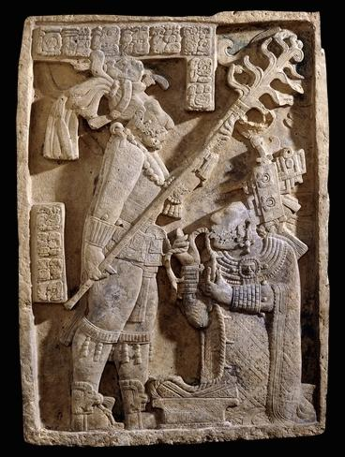
Lintel #24, Yaxchilan (Maya) October 28th, 709 AD
Inside the temple sanctuaries the nobility would perform sacrifices to the gods.
It began as what is called bloodletting, they would pull a string with barbs through soft tissue such as their tongue to get blood which they would burn with incense.
Eventually they turn to human sacrifice and would cut out the hearts of the victims and burn those in the ceremonies.
Notes:
In this image you see a woman (labeled as Lady Xook (pronounced shook)) performing bloodletting where she stabs her tongue and pulls a rope with barbs attached through it. The man standing above her is the King and her husband and he presides over the ritual while she performs the sacrifice. The writing along the top describes the date the ritual took place and who was involved.
Women were incredibly important in the Maya world. They had different jobs than the men but were frequently considered more divine and sacred due to their ability to bear children and create life. This allowed them to participate in religious rituals along with the men.

Slide 38
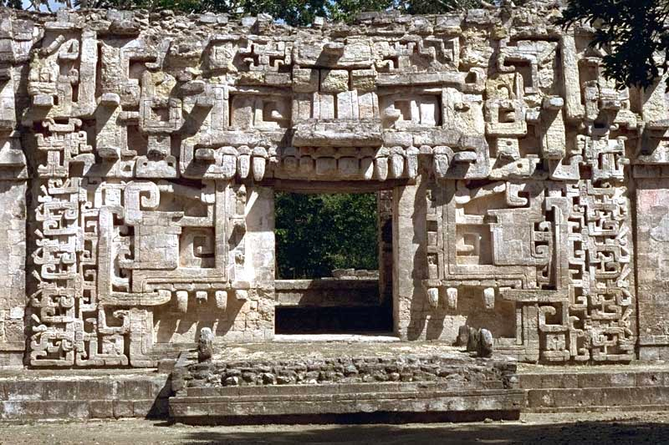
The House of the Serpent Mouth, Chicanna
Notes:
Many entrances to the sanctuaries where they would perform sacrifices were decorated to look like serpents mouths. The serpent was the symbol of a portal to the spiritual realm and so the nobility or priest that was expected to perform the sacrifice would literally be entering a portal to the spiritual realm and perform their ritual in the presences of the gods.
Along the top of the doorway you see the serpent’s teeth, above that are its two eyes.
The steps that are jutting out have teeth lining them

Slide 39
Basic Maya Beliefs
Sacred Text: Popol Vuh
Outlines the creation of the World by the Framer (Xpiyacoc) and the Shaper (Xmucane)
Describes the creation of 3 versions of humans
The mud people “Of earth and mud was its flesh composed. But they saw that it was still not good [...] It’s face could only look in one direction. It’s face was hidden [...] At first it spoke but without knowledge. Straightway it would merely dissolve in water for it was not strong.” -Popol Vuh
The wood people: “They had the appearance of people and spoke like people as well. They populated the whole face of the earth. [...] Nevertheless, they still did not possess their hearts nor their minds. They did not remember their Framer and Shaper.” -Popol Vuh
The maize people: Maize (corn) became the flesh of the people and water was their life blood. “Thus their countenances appeared like people. People they came to be. They were able to speak and converse [...] They were an excellent and chosen people.”-Popol Vuh
Describes the afterlife in Xibalba (pronounced Shibalba)
Notes:
Creation of the World: Began as darkness and water. Then the Framer and Shaper who lived in the water created land and light and animals. They created 3 versions of humans, the final version, the Maize people are the Maya people.
The Maya afterlife had 2 locations. The heavens or Xibalba (pronounce Shibalba). Xibalba was the underworld and was ruled by underworld gods while the heavens contained the creator gods such as the Framer and Shaper and all of your ancestors.

Slide 40
Basic Maya Beliefs
Every Maya city was located next to a volcano and body of water.
Volcano: center of creation; in Mayan called Paxil (pronounced Pasheel)
The maize that was used to create humans was found on the first Paxil or volcano
Body of Water: waters of creation; in Mayan called Cayala
The world started as just water but out of these waters came Paxil
Maize is incredibly sacred since their bodies were made of it. Only women are allowed to cook Maize. Men may farm Maize but after they have harvested it they aren’t allowed to touch it unless they are eating it.
The World Tree:
Serpent Portals: Nobility were able to call gods through portals to communicate with them in the temples, the portals were typical depicted as Serpent mouths
Only people of noble blood were allowed to be artists
Notes:
The world started out as just water and these were called the waters of creation then out of the waters came Paxil (Pasheel) which was a volcano and center of creation. Almost all Maya cities were located near a volcano and body of water so they could be close to the center of creation
Maize (corn) was sacred to the Maya people and only women were allowed to work the maize into food. Women are able to create new life and therefore were considered sacred beings. That is why they are allowed to work with the Maize which what their bodies are made of.
The World Tree is a common image that you see in Maya art.
Serpent Portals: Nobility and other creators were able to call souls and spirits through serpent portals. Serpent portals were also reminiscent of the umbilical cord because you are bringing life through a portal from the spirit world into the mortal world.
The very act of creating art was considered sacred. Images were imbued with souls and so anyone who could create images were beings of creation. If you had noble blood you were more closely tied to the gods and would have more creative blood in your system.

Slide 41
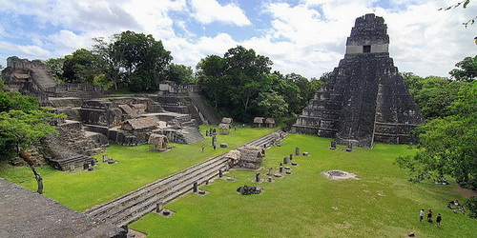
Maya Architecture: Tikal
Notes:
Large open courtyards characterized by towering pyramid temples.
Open courtyards symbolize the waters of creation and the pyramid temples symbolize the volcano or mountain of creation.
Only the nobility was allowed to climb the temples and enter the sanctuaries at top

Slide 42
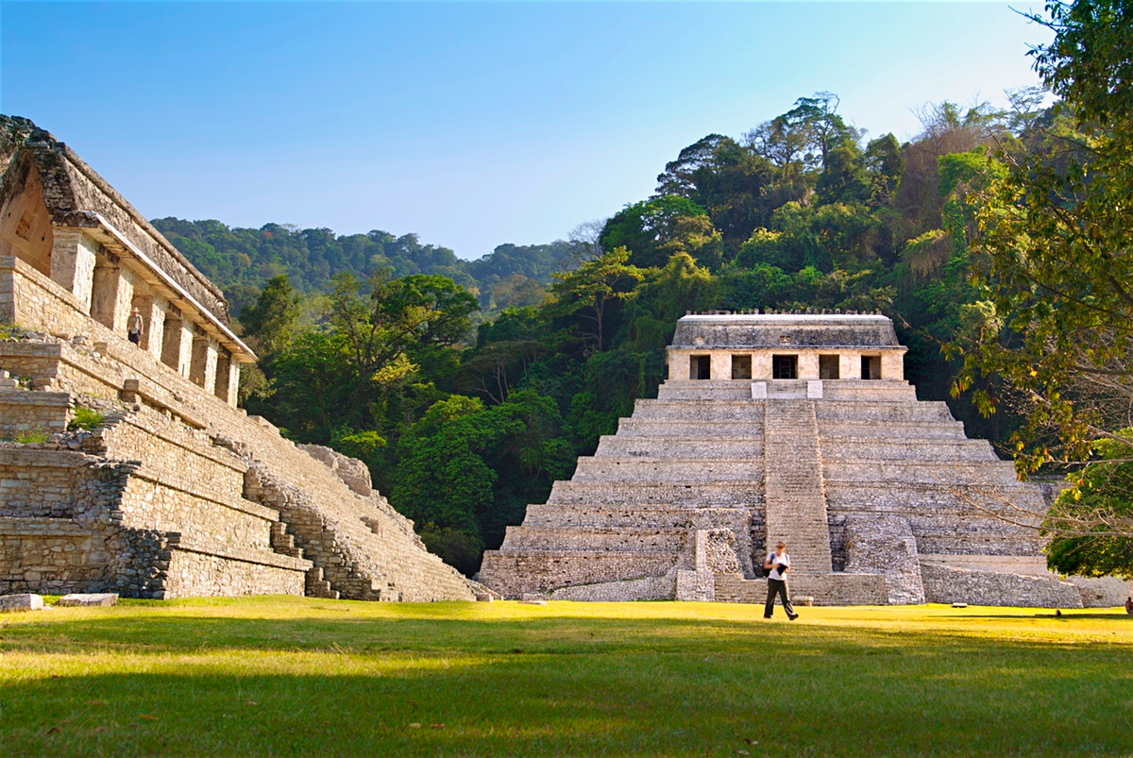
Architecture: Palenque
Notes:
Again we see a large courtyard with pyramids coming up symbolizing the mountains of creation and the waters of creation

Slide 43
Watch Clip
https://www.youtube.com/watch?v=20aHetu6NRw&list=PLtW7akrQ0YvfvCV5Vk79QzbbKep-OIKVA&t=1
While you watch write down elements of art and architecture that we have talked about so far
Ex: You can see the giant olmec heads in the cave

Slide 44
Ender

Slide 45
Day 4

Slide 46
Starter

Slide 47
Finish Projects
You must send an emailed copy of your powerpoint, pamphlet, script, etc by the end of class

Slide 48
Ender

Slide 49
Day 5

Slide 50
Presentations!!

