Slide 1
Color Code
Taylor Hartman

Slide 2
RED

Slide 3
Strengths

As an individual







Excels with logical thinking
Committed to a productive lifestyle
Dynamic and direct
Thrives on independence
Natural leader
Highly resourceful (strong survivor)
Creative in crisis

Slide 4
As a friend






Direct and quick with suggestions
Great in emergencies
Direct and quick with disasters
Promotes group activities
Engages in conflict comfortably and directly
Productive in solving dilemmas

Slide 5
Limitations

As an individual









Generally seeks to serve self (what’s in it for me)
Promotes turmoil and conflict when a personal goal is to be
gained
Out of touch with own feelings
Rationalizes and denies own failings
Always right
Cannot relax and feel comfortable unless producing something
Often arrogant and defiant of authority
Inconsiderate of other’s feelings (selfish)
Inpatient with others

Slide 6
As a friend








Insensitive and unemotional
Doesn’t like to admit the need for friendship
Remains detached from sharing self completely
Enters friendship asking“what’s in it for me?”
Listens only when convenient
Maintains mostly rational friendships
Tries to control group activities
Expects friends to do things his or her way

Slide 7








Won’t admit inadequacies for fear of losing power and
control
Negative, critical, and judgmental of others
Feels it is more important to be right than agreeable
Blunt or rude when angered
Boring
Expects to be entertained while waiting for action to
begin
Stubborn
Denies any personal inadequacies of responsibility

Slide 8
How to Develop a Positive Connection
with Reds
Do’s
 Present issues logically
 Demand their attention and respect
 Do your homework!
 Be direct, brief and specific in conversation
 Be productive and efficient
 Offer them leadership opportunities
 Verbalize your feelings
 Support their decisive nature
 Promote their intelligence reasoning where appropriate
 Be prepared with facts and figures
 Respect their need to make their own decisions their own way

Slide 9
Don’ts










Embarrass them in front of others
Argue from an emotional perspective
Always use authoritarian approach
Use physical punishment
Be slow and indecisive
Expect a personal and intimate relationship
Attack them personally
Take their arguments personally
Wait for them to solicit your opinion
Demand constant social interaction (allow for alone time)

Slide 10
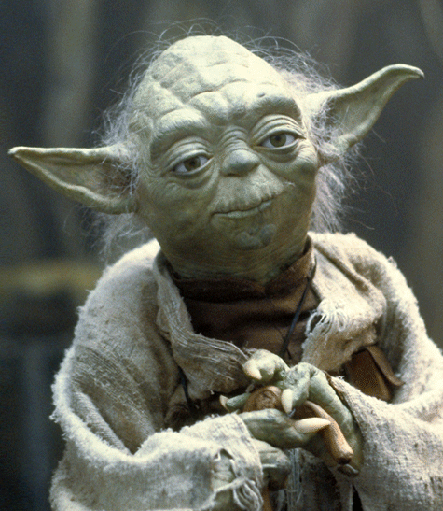
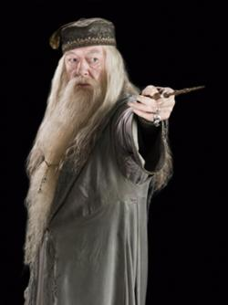
WHITE

Slide 11
Strengths
As an individual
Quiet, reflective, and peaceful
Sincere and genuine lifestyle
Appears to accept life comfortably
Patient with others
Kind to animals and people
Blends into all situations








Slide 12
As a friend










Patient and enduring through good and bad times
Tolerant of unkind behavior
Supportive and accepting
Listens with empathy
Relaxed in most situations
Likes most people
Liked by most people
Compatible with different personalities
Enjoys observing others
Non-demanding of friendships

Slide 13
Limitations
As an individual
 Boring because detached
 Takes passive approach to life
 Unresponsive or not openly excited about experiences
 Has problems becoming intimate
 Bashful and unsure of self
 Easily manipulated into changing plans
 Ambivalent about direction and goals to pursue
 Often lazy and unwilling to take responsibility for self
 Resists making commitments

Slide 14
As a friend






Lacks creativity to make suggestions
Easily led by others opinions
Won’t express honest perspective if controversial
Passive
Requests extra protection and a lot of support
Easily hurt and defeated

Slide 15
How to Develop a Positive Connection
with White
Do










Be kind
Be logical, clear and firm about the content you present
Provide a structure (boundaries) for them to operate in
Be patient and gentle
Introduce options and ideas for their involvement
Be simple and open
Acknowledge and accept their individuality
Be casual, informal, and relaxed in presentation style
Look for nonverbal clues to their feelings
Listen quietly

Slide 16
Don’t










Be cruel and insensitive
Expect them to need much social interaction
Force immediate verbal expressions; accept written
communication
Be domineering and too intense
Demand conformity to realistic expectations/behaviors
Overwhelm them with too much at once
Force confrontation
Speak too fast
Take away all their daydreams
Demand leadership

Slide 17
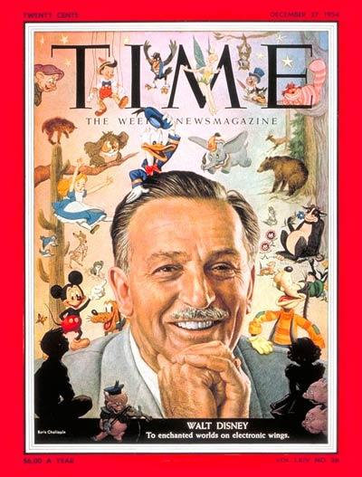
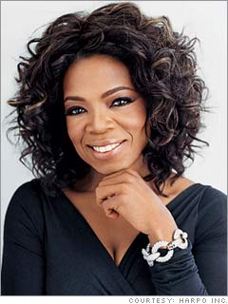
BLUE

Slide 18
Strengths

As an individual








Sees life as a serious endeavor
Appreciates beauty and detail
Has a strong aesthetic sense
Stable and dependable (plowhorse vs. racehorse)
Sincere and emotionally deep
Analytically oriented (concerned with why one behaves as
she/he does)
High achiever
Deep sense of purpose

Slide 19

As a friend





Loyal forever once friendship is established
Genuine concern for other person’s well-being
Remembers special holidays and promotes celebrations
Encouraging in times of trouble
Willing to commit time to the relationship

Slide 20
Limitations
As an individual




Highly emotional
Smug and self-righteous
Controlling and/or envious of others’ success when too
easily obtained
Strong perfecting and performance orientation

Slide 21
As a friend








Highly insecure about other’s and approval
Feels rejected easily
When depressed or depressive, feels it is friend’s job to
understand
Can be revengeful and bitter if crossed or scarred
emotionally
Critical of friends’ principles or activities if not similar
Expects friends to maintain strong loyalty
Wishes friends would communicate more often
Rarely playful and spontaneous

Slide 22
How to Develop a Positive Connection
with Blue
Do’s
 Emphasize their security in the relationship
 Be sensitive and soft-spoken in your approach
 Be sincere and genuine
 Behave appropriately and well mannered
 Limit their risk level
 Promote their creativity
 Appreciate them
 Allow ample time for them to gather their thoughts before
expressing themselves
 Be loyal
 Do thorough analysis before making presentations

Slide 23
Don’ts











Make them feel guilty
Be rude or abrupt
Promote too much change
Expect spontaneity
Abandon them
Expect them to bounce back easily or quickly from depression
Demand perfection (they already expect too much from
themselves)
Push them too quickly into making decisions
Expect them to forgive quickly crossed
Demand immediate action or quick verbal bantering

Slide 24
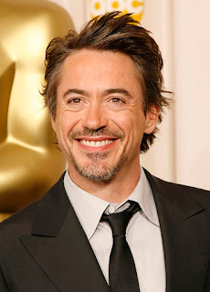
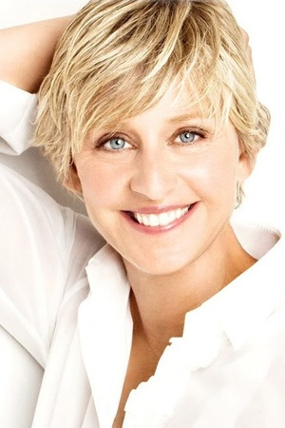
YELLOW

Slide 25
Strengths
As an individual
 Highly optimistic (rarely depressed)
 Likes self and accepts others easily
 Loves to volunteer for opportunities
 Sees life as an experience to be enjoyed
 Flashy (racehorse rather then plowhorse)
 Adventurous and daring

Slide 26
As a friend







Exciting and fun to be with (never dull or boring)
Often places friend before family
Forgiving of self and others
Lively and entertaining
Vulnerable, innocent, and trusting
Endearing
Willing to free up schedule in order to play

Slide 27
Limitations
As an individual
 Needs to look good socially (high priority)
 Irresponsible and unreliable
 Self-centered and egotistical
 Flighty and uncommon
 Lots of talk with little action
 Superficial and mostly interested in a good time
 Unwilling to experience pain in order to produce quality
 Undisciplined
 Loud and obnoxious in public places
 Exaggerates successes and omits unpleasant trysts
 Unable to confront or face issues

Slide 28
As a friend








Spends most of time discussing own life
Shows up at his or her convenience
Undependable in a crisis
Unwilling to commit to long-term needs of distressed
friends
Pursues one’s life regardless of friend’s situations or needs
Uncomfortable in painful or distressing environments
Makes new friends easily and without guilt, often at the
expense of old friends

Slide 29
How to Develop a Positive Connection
with Yellow
Do’s
 Be positive and proactive with them in your life
 Adore and praise them legitimately
 Touch them physically
 Accept their playful teasing
 Remember they are more sensitive than they appear
 Value their social interaction skills and people connections
 Remember they hold feelings deeply
 Promote creative and fun activities for and with them
 Enjoy their charismatic innocence
 Allow them opportunity for verbal expression

Slide 30
Don’ts










Be too serious or sober in criticism
Push them too intently
Ignore them
Forget they have“down” time also
Demand perfection
Expect them to dwell on problems
Give them too much rope,or they may hang themselves
Classify them as just lightweight social butterflies
Attack their sensitivity to be unforgiving
Totally control their schedules or consume their time

