Slide 1
UNIT 1:ORIGINS OF CIVILIZATION

Slide 2
WHY STUDY WORLD HISTORY?

Slide 3
Preassessment
What is a Thesis Statement?
What does Mesopotamia mean?
Why did Ancient Egypt develop along a river?

Slide 4
WARM UP: WHAT DO YOU THINK?
Groups of two, brainstorm ideas for why we study world history.

Slide 5
CONNECTION
https://www.youtube.com/watch?v=Pwe-pA6TaZk

Slide 6
HISTORY SHOWS US WHAT IT MEANS TO BE HUMAN.
http://www.gandhi-king-ikeda.fi/lehdisto.html

Slide 7
HISTORY GIVES US HEROES.
http://www.sonofthesouth.net/leefoundation/civil-war/1865/president-abraham-lincoln.htm

Slide 8
HISTORY ALLOWS US TO LEARN FROM OTHERS’ MISTAKES.
http://www.literacyrules.com/jim_crow2.htm

Slide 9
HISTORY FOSTERS EMPATHY.

Slide 10
HISTORY HELPS US APPRECIATE BEAUTY.
http://www.envocare.co.uk/taj_mahal_history.htm

Slide 11
HISTORY IMPROVES JUDGMENT.
http://www.waveflux.net/archives/cat_politics.php

Slide 12
HISTORY HELPS US RECOGNIZE TRENDS.
http://www.eere.energy.gov/vehiclesandfuels/facts/2005/fcvt_fotw364.shtml

Slide 13
HISTORY INSPIRES US.

Slide 14
HISTORY MAKES US BETTER THINKERS.
http://www.hull.ac.uk/philosophy/phil-home1.htm

Slide 15
HISTORY MAKES US BETTER READERS.

Slide 16
HISTORY MAKES US BETTER WRITERS.

Slide 17
HISTORY NURTURES OUR IMAGINATION.
Notes:
Nazca lines

Slide 18
HISTORY HELPS US REMEMBER.

Slide 19
HISTORY HELPS US ACKNOWLEDGE OTHER PEOPLE’S PERSPECTIVES.
Notes:
Is there a way to make this upside down?

Slide 20
HISTORY PROVIDES INSTRUCTIVE EXAMPLES.
http://www.estatevaults.com/lm/archives/002123.html

Slide 21
HISTORY SATISFIES A NEED FOR IDENTITY.
http://wyoming.gov/state/images/home_page/historic/historic.asp

Slide 22
HISTORY HELPS US TO UNDERSTAND AND BE TOLERANT OF OTHER CULTURES.
http://www.photographersdirect.com/news/200407.asp

Slide 23
HISTORY PREPARES US FOR CIVIC INVOLVEMENT.

Slide 24
HISTORY IS FUN.

Slide 25
DAY 2

Slide 26
WHAT IS A CIVILIZATION?

Slide 27
WARM UP: WHAT IS A CIVILIZATION?
In groups of 4 make a concept map of what you think a civilization is and copy the main idea to your warm-up paper

Slide 28
NOTE TAKING

Slide 29
??

Slide 30
WOOO! CORNELL NOTES
Most important information in the right hand column, details in the left. Right hand filled out afterwards.
Tarzan language. Bullets.
Summary at the bottom
Checked randomly for completion
Help on quizzes

Slide 31
TRUE OR FALSE?
Human beings evolved in different places around the planet, that is why we have different races.

Slide 32
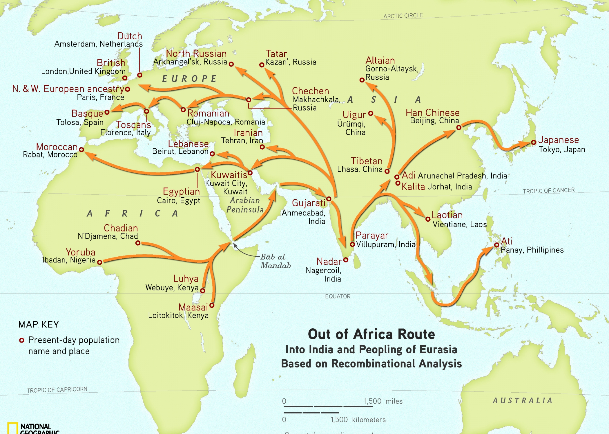
THE GREAT HUMAN MIGRATION
https://www.youtube.com/watch?v=CJdT6QcSbQ0
Originated in Africa 200,000 years ago, left Africa 100,000 years ago.
Humans are 99.9% genetically identical
Notes:
Humans originated in Africa about 200,000 years ago. Migrate 100,000 years ago. Probably only about 1,000 people left africa.
All humans are about 99.9 genetically identical.
One woman 150,000 years ago.

Slide 33
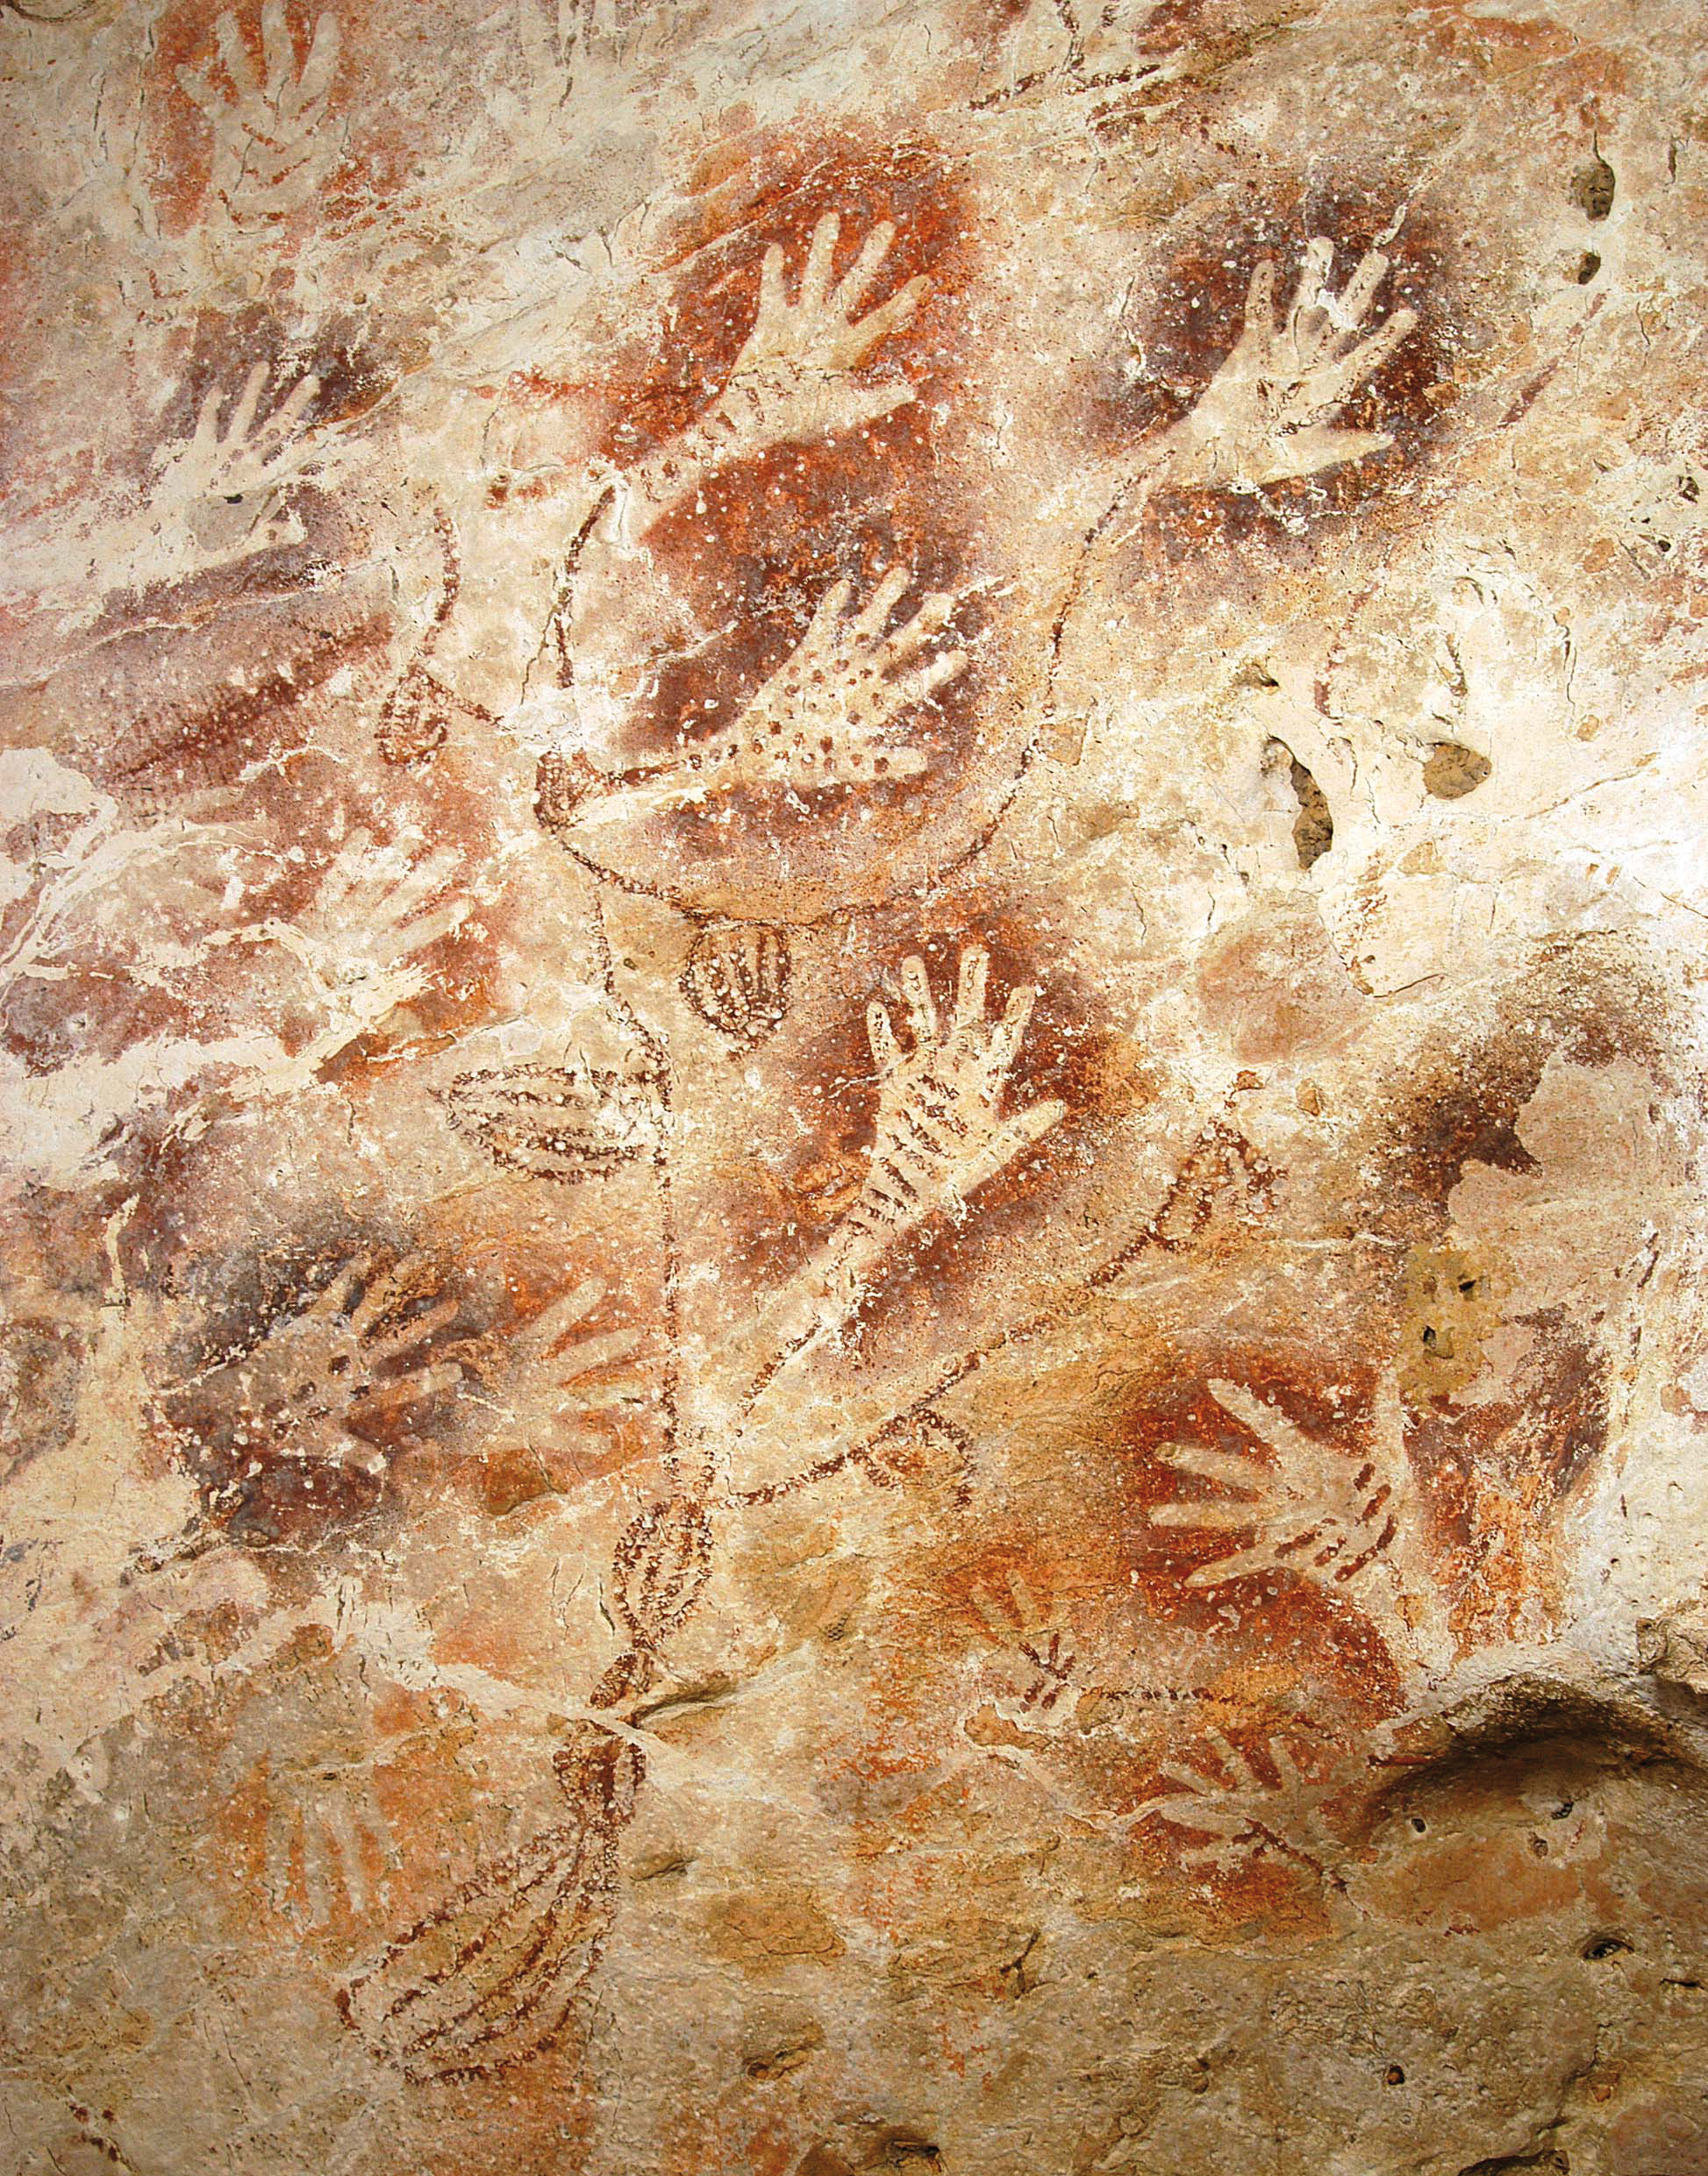
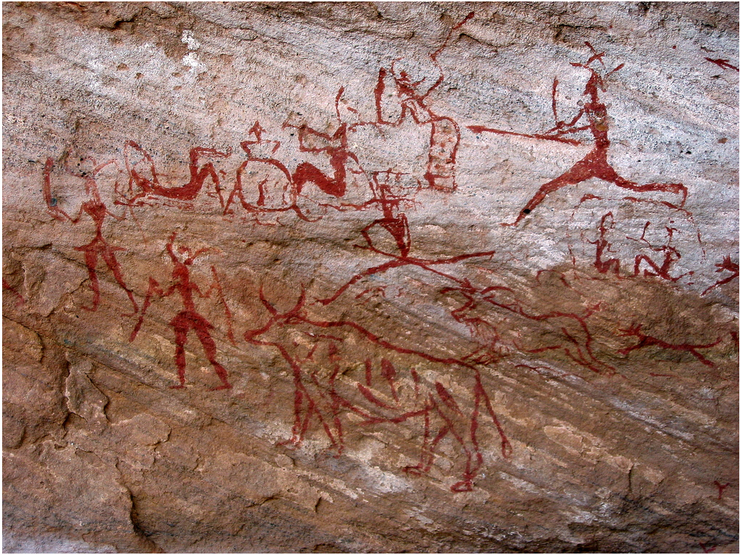
ABSTRACT REPRESENTATION

Slide 34
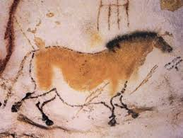
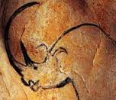
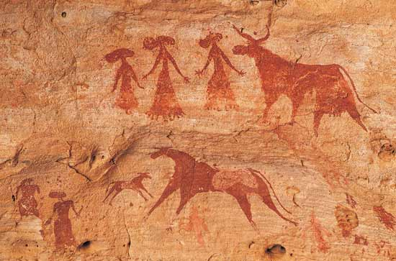
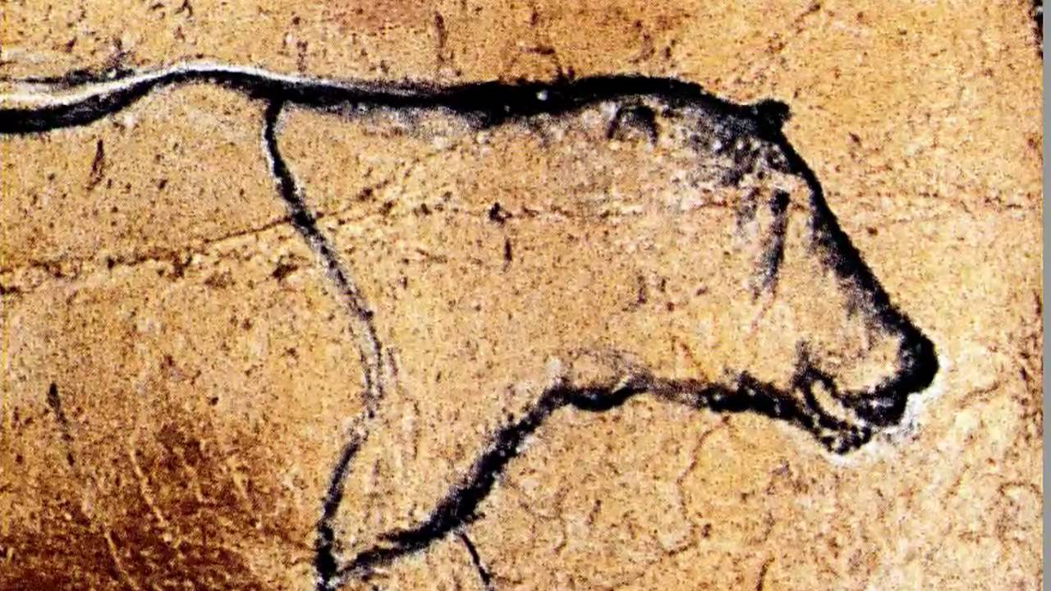

Slide 35
WHAT CAN WE LEARN ABOUT THEIR RELIGION? LIFESTYLE?

Slide 36
Religion and Lifestyle
Animism: Belief that all things have spirits. Paintings may have been made to honor animal spirits.
Paleolithic people buried their dead. What can this teach us?

Slide 37
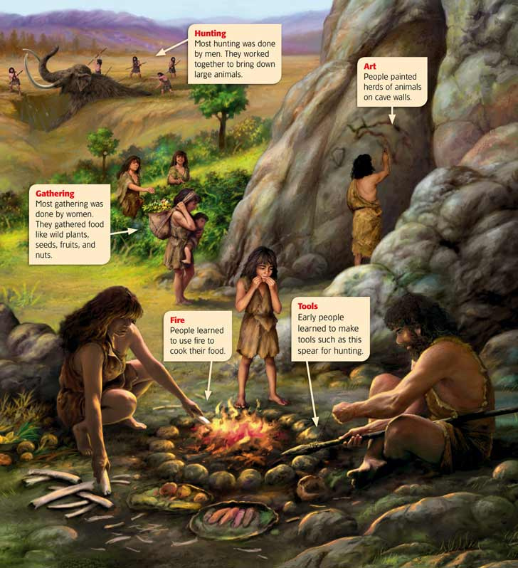
HUNTING AND GATHERING
Lived as nomads
Hunt, fish, berries, and nuts.
Men and women were likely equals.

Slide 38
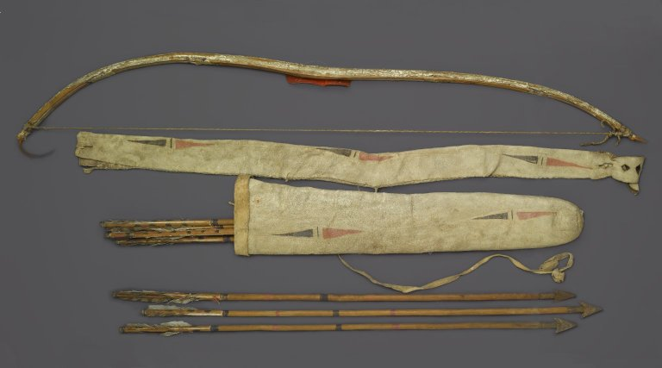
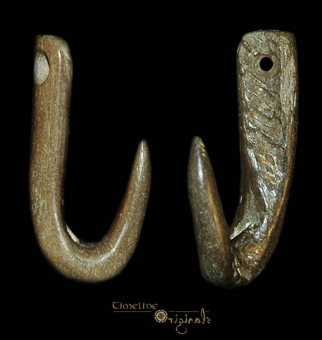
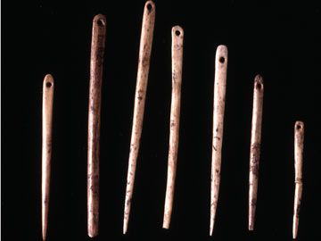
TECHNOLOGY

Slide 39
NEOLITHIC REVOLUTION

Slide 40
When we went from this...

Slide 41
To this!

Slide 42
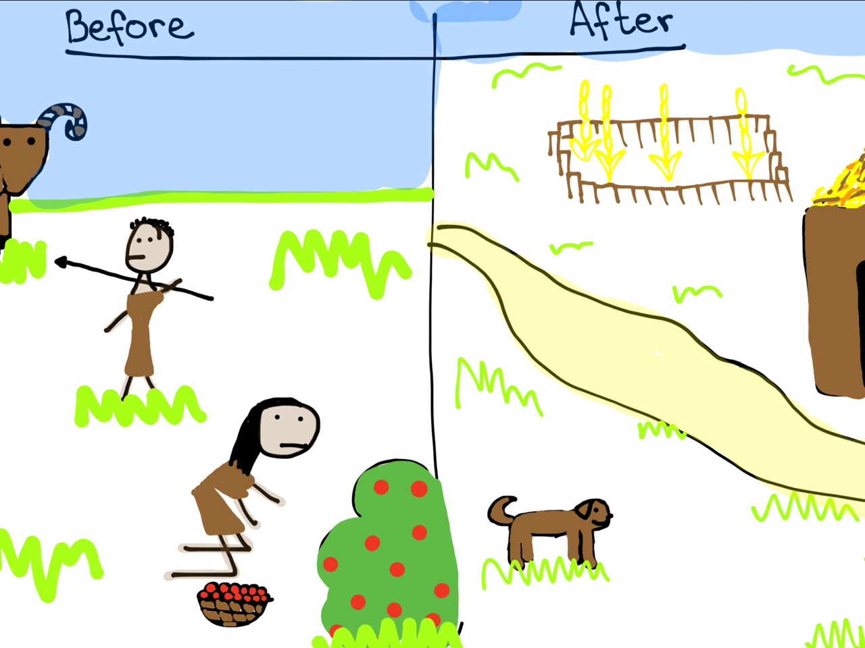
NEOLITHIC REVOLUTION
Started about 10,000 BCE
“Neo” = New
“Lithic”= Stone
Agricultural revolution

Slide 43
WHAT IS NEEDED FOR AGRICULTURAL REVOLUTION/NEOLITHIC REVOLUTION?
Write to learn
Notes:
Water
People grouping together
Working together
Collective decisions
Language
Understand how to grow things

Slide 44
URBAN REVOLUTION: CIVILIZATION

Slide 45
OBSERVATION AND INFERENCE

Slide 46
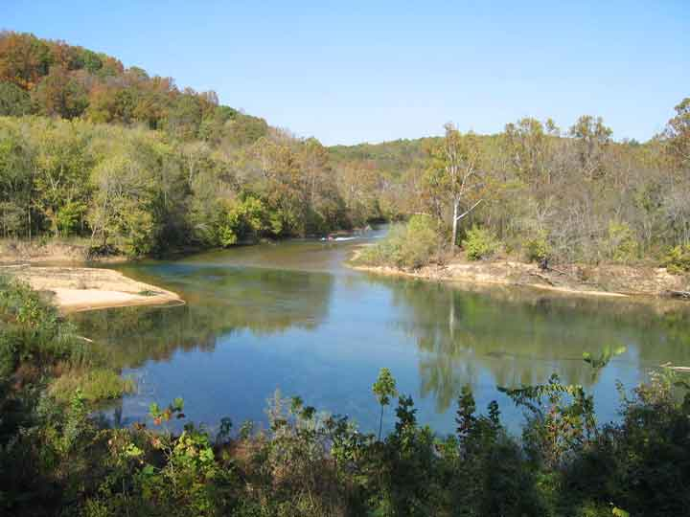
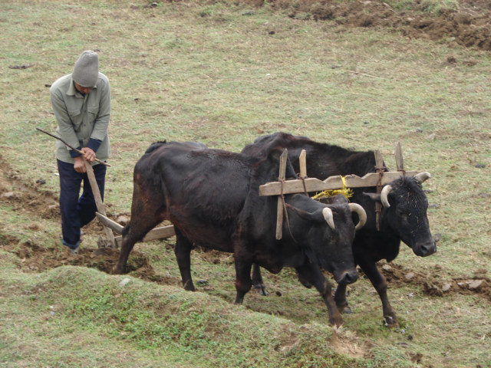
BUILDING BLOCKS OF CIVILIZATION
Water
Language
Writing
Technology

Slide 47
CHARACTERISTICS OF CIVILIZATION
Cities
Religion
Organized Government
Public Works
Jobs
Art and Architecture
Writing
Social Classes
C.R.O.P.
J.A.W.S.
Notes:
O R J S A P C W
Jaws crop

Slide 48
FIRST CIVILIZATIONS
Mesopotamia (Iraq)
Nile River Valley (Egypt)
Indus River Valley (India)
Huang He/Yellow River (China)

Slide 49
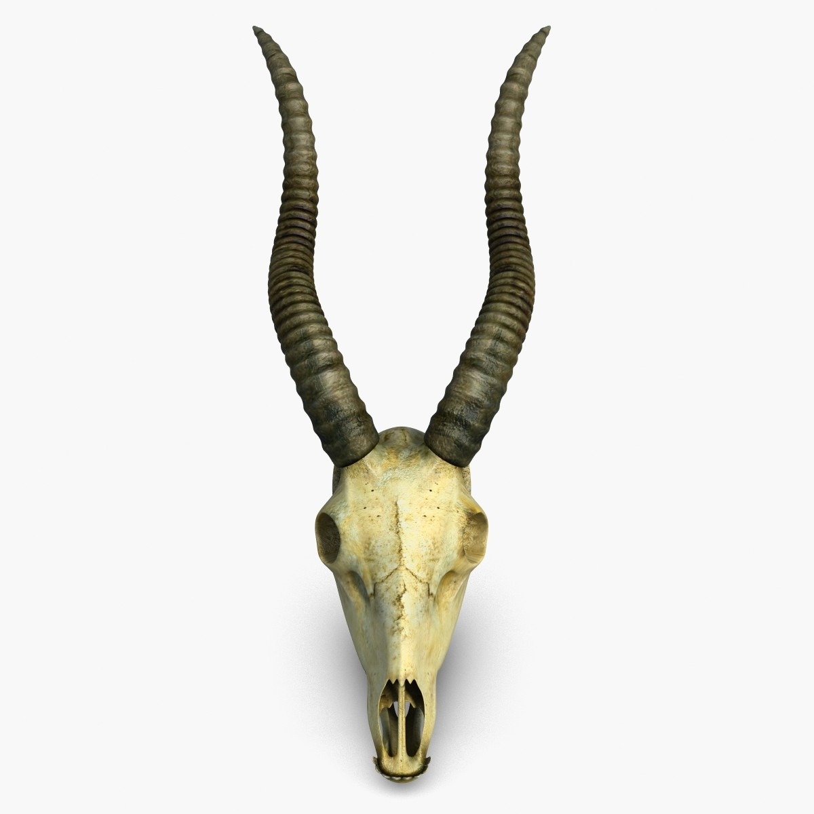
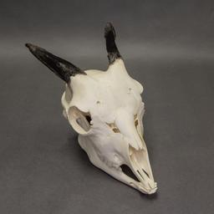
DOMESTICATION

Slide 50
DOMESTICATION

Slide 51
SOCRATIC SEMINAR
THE NEOLITHIC REVOLUTION

Slide 52
THE NEOLITHIC REVOLUTION AND CIVILIZATION WAS DEFINITELY A GOOD THING.

Slide 53
DISEASE

Slide 54
SLAVERY

Slide 55
OVERPOPULATION

Slide 56
POLLUTION

Slide 57
SEXISM

Slide 58
Turritopsis dohrnii
What in tarnation is this?
T. dohrnii
Turritopsis
Oceaniidae
Anthoathecata
Hydrozoa
Cnidaria
Animalia
Species:
Genus:
Family:
Order:
Class:
Phylum:
Kingdom:
Thesis:
A good argumentative thesis is centered on a debatable topic. ...
A good argumentative thesis picks a side. ...
A good thesis makes claims that will be supported later in the paper. …
State your Thesis:
When in Doubt, fill this out.
In this paper (argument, discussion) I want to prove that,_________________ ________<Thesis Statement>,________
because,
<Claim>,_________________________ <Claim>, ___________________ <Claim>_________________________

Slide 59
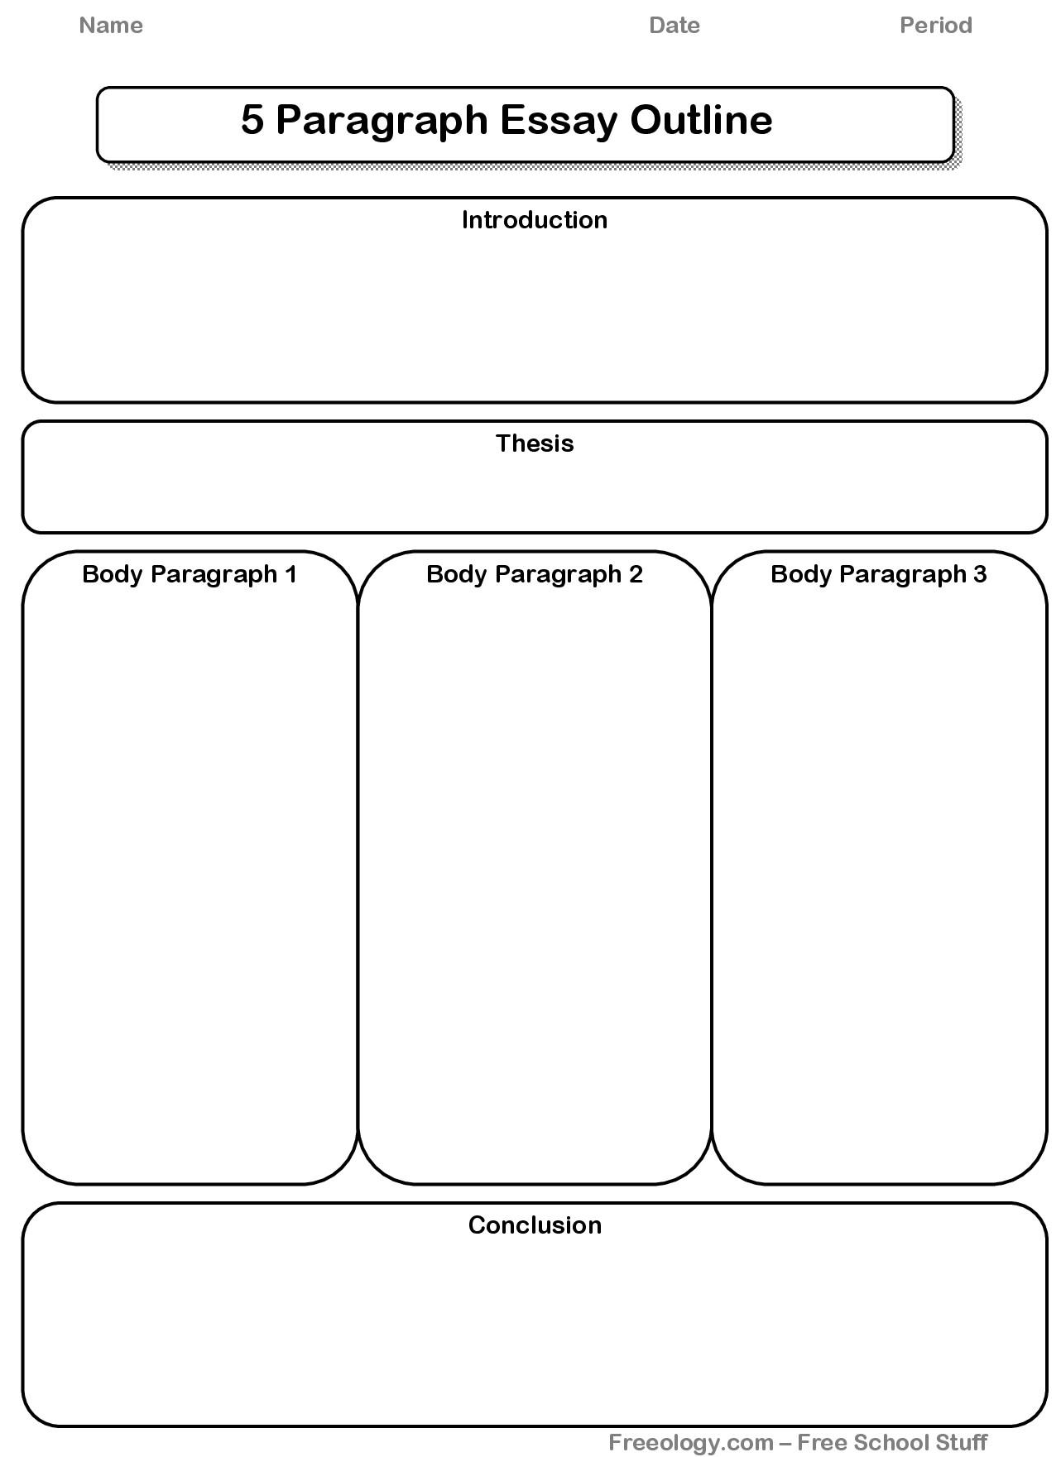

Slide 60
Write a Thesis

Slide 61
Write a Thesis

Slide 62
Write a Thesis
Write a specific, clear, thesis:
“Was the Neolithic revolution a good thing? Is civilization always a good thing?”
Turn into box when done.

Slide 63
Geography Assignment

Slide 64
Summarize Notes

Slide 65
Day 3

Slide 66
WARM-UP
What are the key characteristics of a civilization? Why are each of them significant?

Slide 67
MESOPOTAMIA
THE FIRST CIVILIZATION

Slide 68
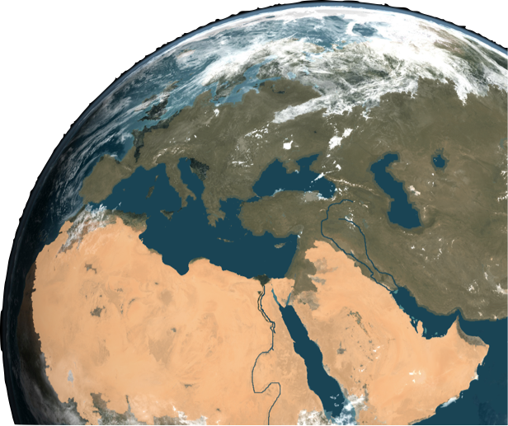
4,400,000 BC
100,000 BC
5,000 BC
3,500 BC
3,000 BC
Earliest Known human
ancestor Lives in Africa
Neanderthals spread
from Africa Into Europe
and Asia
People begin
to settle the
Fertile Crescent
Cities develop
Along the Tigris-
Euphrates Rivers
• King Menes
Unifies Egypt
I. GEOGRAPHY
A. Fertile Crescent
- Curved area in middle east
w/fertile land
B. Mesopotamia,(land between 2 rivers) between the Tigris & Euphrates Rivers.
C. Flooding Rivers forced people to organize
- Govts formed.
Euphrates R.
Tigris R.
Sumer 3,000 B.C.
D. Sumer formed 3,000BC
- 1st Civilization!
Notes:
Review Timeline with Students
In the dry region of the Middle East lies an arc of land that provided some of the best farming in Southwest Asia. The region’s curved shape and the richness of its land led scholars to call it the Fertile Crescent.
Around 5,000 B.C. migrants began to settle in the Fertile Crescent, which included parts of modern Israel, Jordan, Lebanon, Turkey, Iraq, and Syria. Many settled in Mesopotamia, between the Tigris and Euphrates Rivers. The two rivers sometimes flooded and swept away entire villages. So, early Mesopotamian villages cooperated to build dams, escape channels, canals and ditches. As they did, cities formed.
The rivers would flood at least once a year, leaving behind silt that was very fertile for planting crops
The large harvests led to room for expansion and cities
Sumerians had to come up with solutions to deal with these disadvantages
Dug irrigation ditches
Built walled cities
Opened trading with other peoples
These projects took cooperation and good leadership
Beginning of government AND civilization
Sumer becomes the first civilization that we know of. It is the beginning.

Slide 69
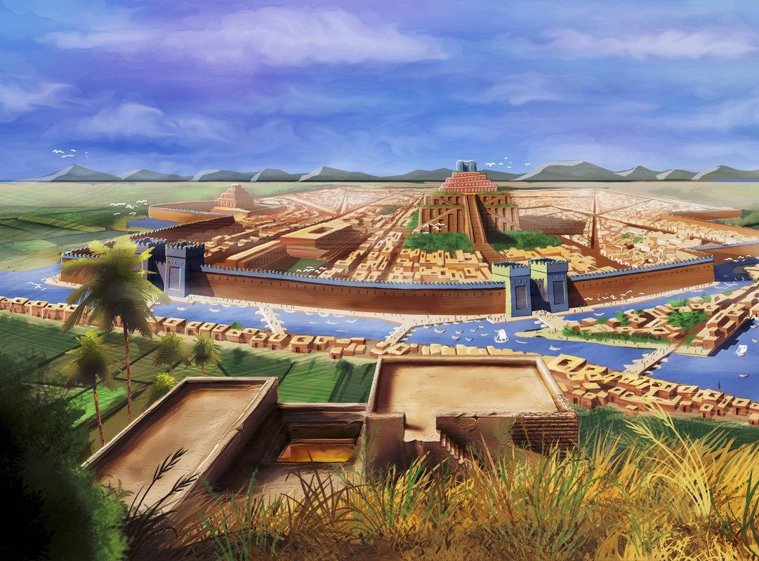
4,400,000 BC
100,000 BC
5,000 BC
3,500 BC
3,000 BC
Earliest Known human
ancestor Lives in Africa
Neanderthals spread
from Africa Into Europe
and Asia
People begin
to settle the
Fertile Crescent
Cities develop
Along the Tigris-
Euphrates Rivers
• King Menes
Unifies Egypt
E. City-state - City & surrounding area w/its own govt
Notes:
By 3000 B.C., the Sumerians had built a number of cities, each surrounded by fields of barley and wheat. Although these cities shared the same culture, they developed their own governments, each with its own rulers. Each city and the surrounding land it controlled formed a city-state. A city-state functioned much as an independent country does today. Sumerian city-states included Uruk, Kish, Lagash, Umma, and Ur. As in Ur .
These city states had many of the characteristics of a civilization we looked at last chapter. Advanced cities
Specialized workers, Complex institutions, Record keeping, technology. Sumerians created many city-states to serve as centers of government

Slide 70
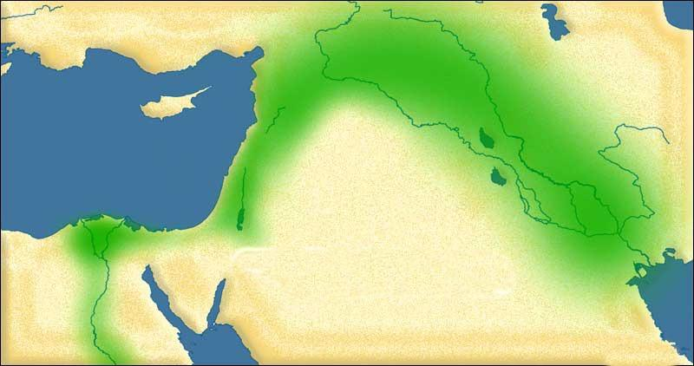
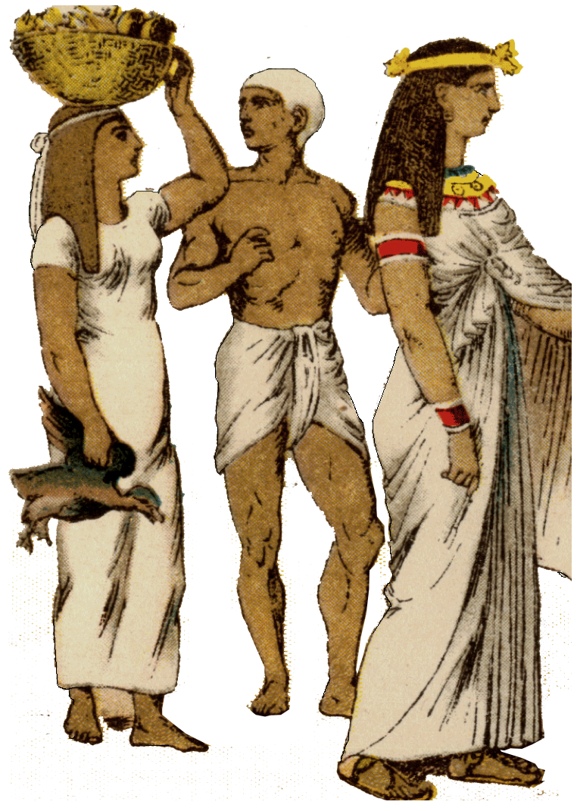
II. Sumerian Society
A. 3 Social Classes
1.
——————
2.
———————
3.
`
Sumer 3,000 B.C.
Notes:
In each city-state, the King was responsible for maintaining the city walls and the irrigation systems. He led its armies in war and enforced the laws. He used scribes -people who could read and write to carry out functions such as collecting taxes and keeping records. The king was seen as the chief servant of the gods and led ceremonies made to please them.
Each Sumerian city-state had a distinct social hierarchy - or system of ranks.
1. The highest class included the ruling family, leading officials, and high priests.
2. A small middle class was made up of lesser priests and scribes. The middle class also included merchants and artisans. Artisans who practiced the same trade, such as weavers or carpenters, lived and worked in the same street.
3. At the base of society were the majority of people, peasant farmers. Some had their own land, but most worked land belonging to the king or temples. Sumerians also owned slaves. Most slaves had been captured in war. Some, though, had sold themselves into slavery to pay their debts.
The role of women in Sumerian society changed over time. In the earliest Sumerian myths, a mother-goddess reflected the honored role of mothers in farming communities. As large city-states emerged with warrior-leaders at their heads, male gods replaced the mother-goddess. Still, in the early city-states, wives of rulers enjoyed special powers and duties. Some supervised palace workshops and ruled for the king when he was absent. Over time, as men gained more power and wealth, women became more dependent on men. Yet women continued to have legal rights. Well-to-do women engaged in trade and owned property.

Slide 71
II. Sumerian Society
A. 3 Social Classes
1. Kings, head
officials, &
high priests
——————
2. Middle class of priests, scribes, merchants & artisans
———————
3. Peasant farmers, slaves.
`
Sumer 3,000 B.C.
Notes:
In each city-state, the King was responsible for maintaining the city walls and the irrigation systems. He led its armies in war and enforced the laws. He used scribes -people who could read and write to carry out functions such as collecting taxes and keeping records. The king was seen as the chief servant of the gods and led ceremonies made to please them.
Each Sumerian city-state had a distinct social hierarchy - or system of ranks.
1. The highest class included the ruling family, leading officials, and high priests.
2. A small middle class was made up of lesser priests and scribes. The middle class also included merchants and artisans. Artisans who practiced the same trade, such as weavers or carpenters, lived and worked in the same street.
3. At the base of society were the majority of people, peasant farmers. Some had their own land, but most worked land belonging to the king or temples. Sumerians also owned slaves. Most slaves had been captured in war. Some, though, had sold themselves into slavery to pay their debts.
The role of women in Sumerian society changed over time. In the earliest Sumerian myths, a mother-goddess reflected the honored role of mothers in farming communities. As large city-states emerged with warrior-leaders at their heads, male gods replaced the mother-goddess. Still, in the early city-states, wives of rulers enjoyed special powers and duties. Some supervised palace workshops and ruled for the king when he was absent. Over time, as men gained more power and wealth, women became more dependent on men. Yet women continued to have legal rights. Well-to-do women engaged in trade and owned property.

Slide 72
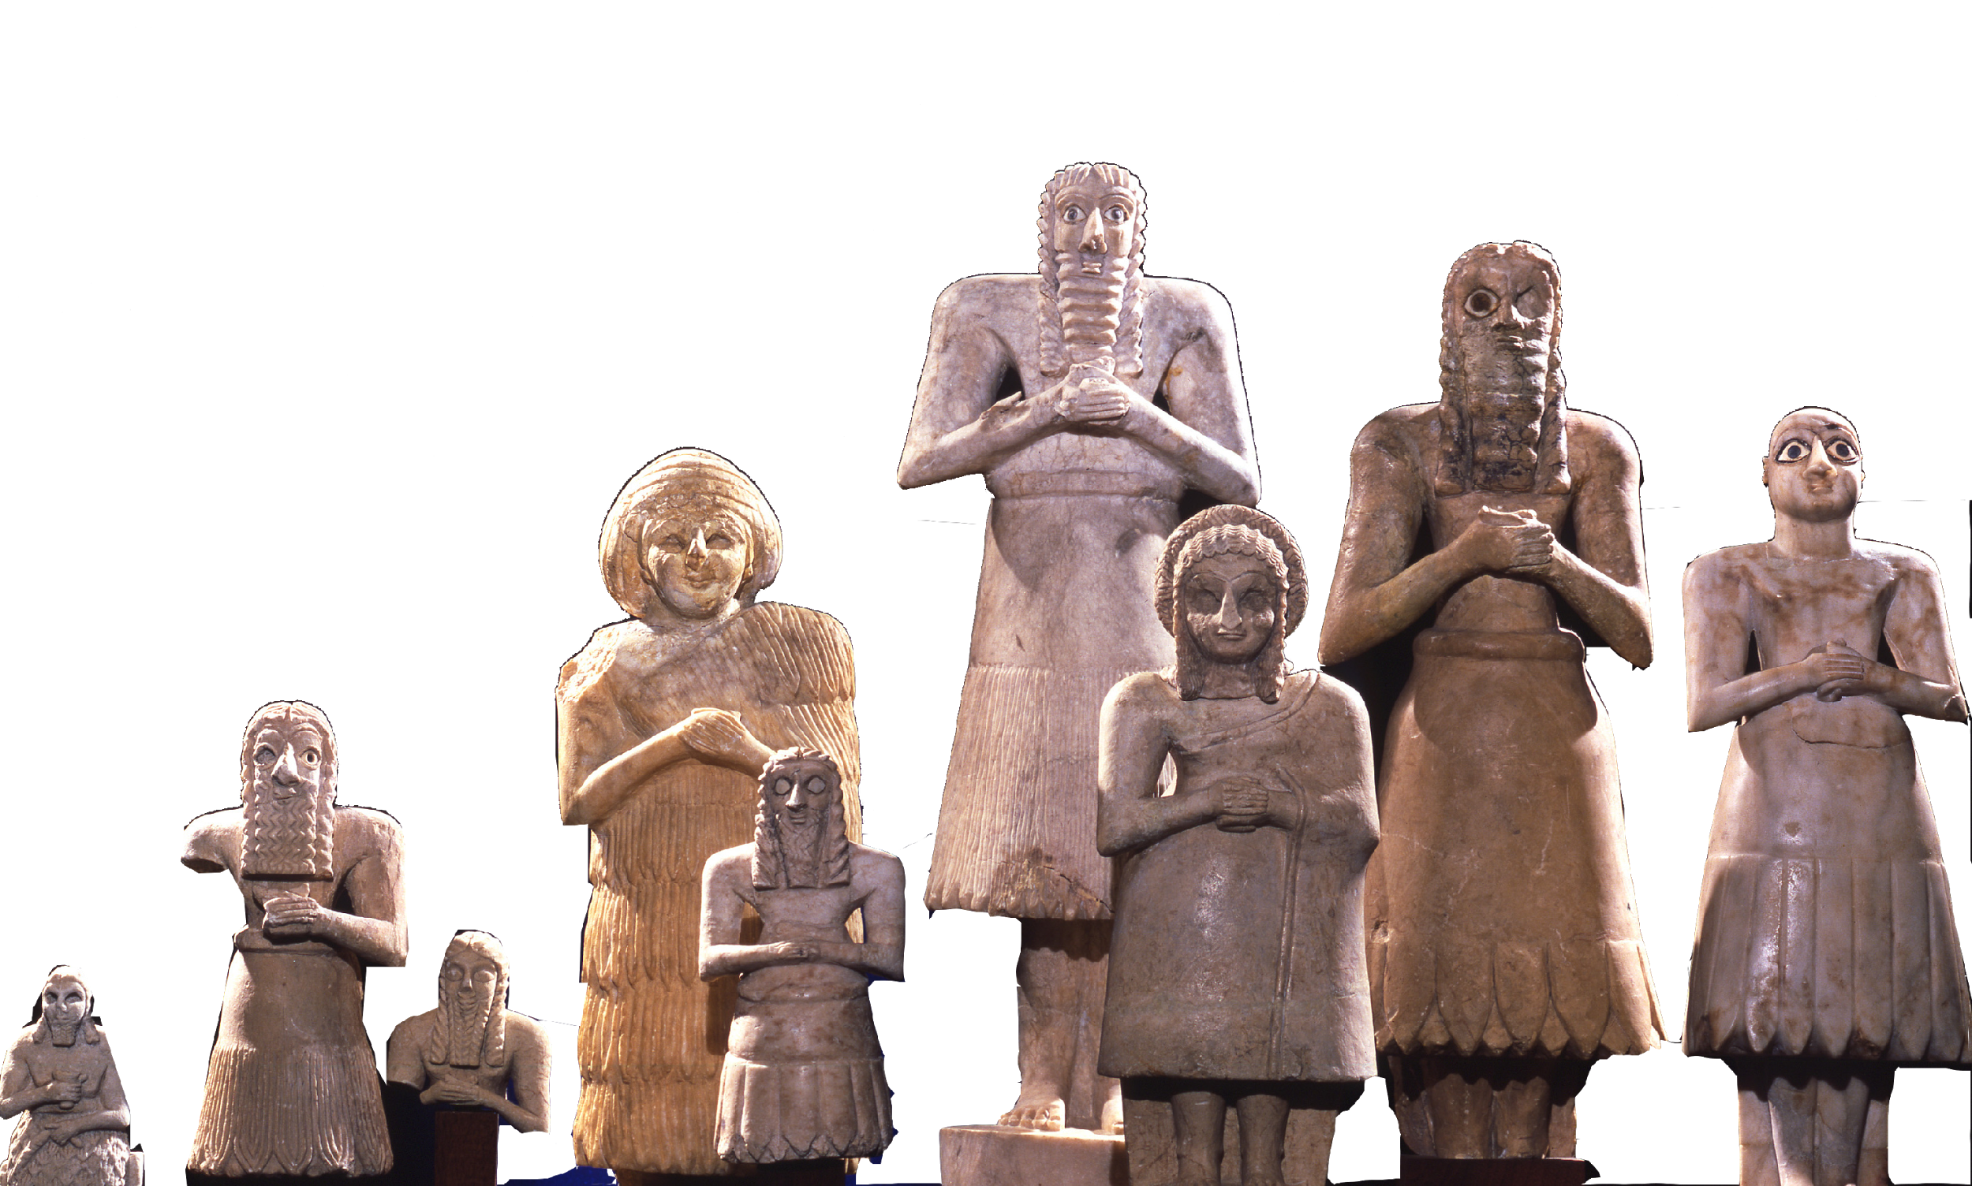
III. Sumerian Religion
1. Polytheistic religion - belief in many gods
- Gods looked like people
- Controlled nature
- Sacrificed food & animals to gods
"the place where they live on dust, their food is mud, . . . and they see no light, living in blackness on the door and door-bolt, deeply settled dust."
--The Epic of Gilgamesh
- Saw the afterlife as a grim place.
F. Sumerians are credited with numerous technological inventions, including the wagon wheel, the arch, the sundial and bronze.
Notes:
Like most ancient peoples, the Sumerians were polytheistic, worshiping many gods. These gods were thought to control every aspect of life, especially the forces of nature. Sumerians believed that gods and goddesses behaved like ordinary people. They ate, drank, married, and raised families. Although the gods favored truth and justice, they were also responsible for violence and suffering. They were also immortal.
Afterlife - Analyze Excerpt - This is an excerpt from an ancient Mesopotamian text describing the afterlife. Have a student read it and the class interpret it. Is the afterlife a good place or a bad place?
Afterlife was a dark place even for the good people

Slide 73
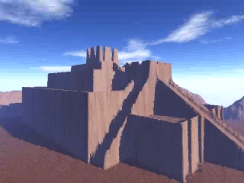
III. Sumerian Religion
C. Ziggurat - a pyramid temple used to sacrifice gifts to the Gods.
- Ziggurat in every city
Notes:
To Sumerians, their highest duty was to keep these divine beings happy and thereby ensure the safety of their city-state. Each city built a ziggurat
Ziggurat - a pyramid-temple that soared toward the heavens. At its top stood a shrine to the chief god or goddess of that city. To win the favor of the gods, the people prayed and offered sacrifices of animals, grain and wine.
They also celebrated holy days with ceremonies and processions. In one ritual, the king went through a symbolic wedding to a goddess to ensure a prosperous new year.

Slide 74
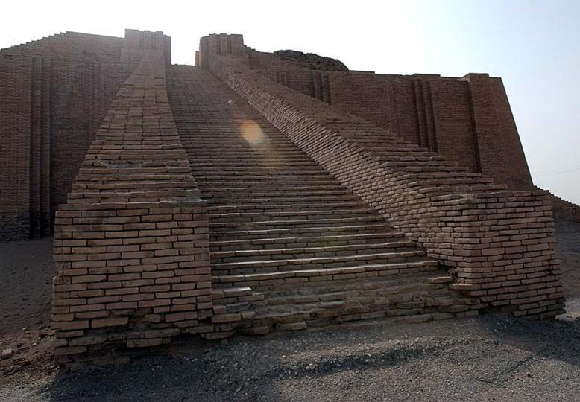
III. Sumerian Religion
C. Ziggurat - a pyramid temple used to sacrifice gifts to the Gods.
- Ziggurat in every city
Notes:
Ziggurat - a pyramid-temple that soared toward the heavens. At its top stood a shrine to the chief god or goddess of that city. To win the favor of the gods, the people prayed and offered sacrifices of animals, grain and wine.
They also celebrated holy days with ceremonies and processions. In one ritual, the king went through a symbolic wedding to a goddess to ensure a prosperous new year.

Slide 75
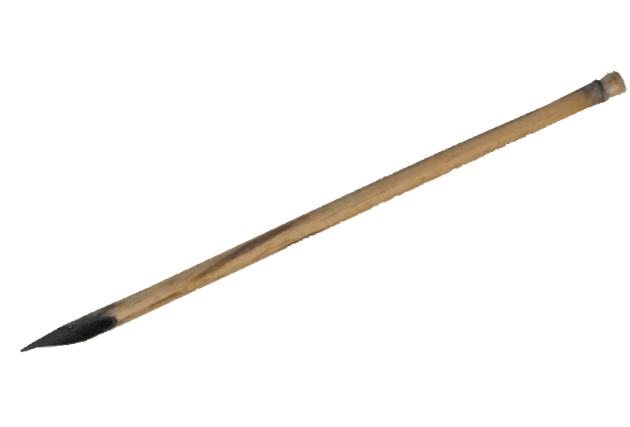
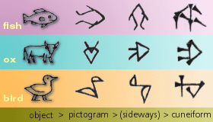
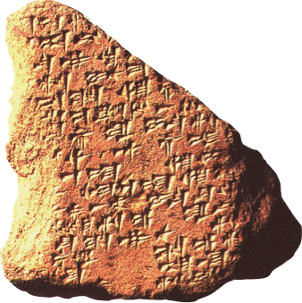
IV. Advances in learning
A. Cuneiform - system of writing invented by the Mesopotamians
- evolved from pictograms
• began to keep accounts &
documented commerce &
trade.
Notes:
By 3200 b.c., the Sumerians had invented what may be the earliest known form of writing. This type of writing was later called cuneiform.
Cuneiform grew out of a system of pictographs that priest used to record goods brought to temple storehouses. Later, priests developed symbols to represent more complicated thoughts. As their writing evolved, the Sumerians were able to use it to record not only grain harvests but also myths, prayers, laws, treaties, and business contracts.
If you remember scribes are people who could officially read and write. Sumerian scribes had to go through years of difficult schooling to acquire their skills.
Do you thinks American schools are strict? In Mesopotamia discipline was strict. Untidy copying or talking in class could be punished by “caning.” Gifted students went on to gain a wide range of knowledge about religion, medicine, mathematics, geography, astronomy, and literature.

Slide 76
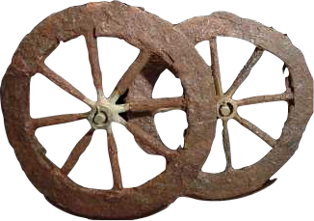
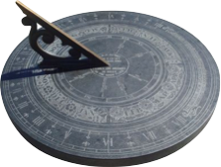
IV. Advances in learning
B. Inventions
- wagon wheel
- sundial
- bronze
- Plow
- basic algebra
- geometry
- sewers
Notes:
Over the centuries, Sumerian scholars made advances in mathematics.
Arithmetic and geometry In order to erect city walls and buildings, plan irrigation systems, and survey flooded fields, Sumerians needed arithmetic and geometry.
They based their number system on six, dividing the hour into 60 minutes and the circle into 360 degrees, as we still do today. Priests studied the skies, recording the movement of heavenly bodies. This knowledge enabled them to make accurate calendars, which are so essential to a farming society.

Slide 77
Observation and Inference
Make a T Chart on your paper. put observations on the left side and inferences on the right.
Look at the image for a couple seconds
What do you see?
These are your observations
Make them simple
There is a man on a horse
He holds a gun
There is a dog
Now that we have made some observations think about what those observations might mean.
These will be your inferences.
The man is probably hunting because he has a gun
etc.
We will be doing this with various works of art from the Mesopotamian Region.

Slide 78
Example Observation/Inference Chart
Observations | Inferences
Man on a horse Holds a gun Dog with him Has nice clothes | The man is probably hunting because he holds a gun He has a hunting dog with him He is probably fairly wealthy due to his nice clothes.

Slide 79
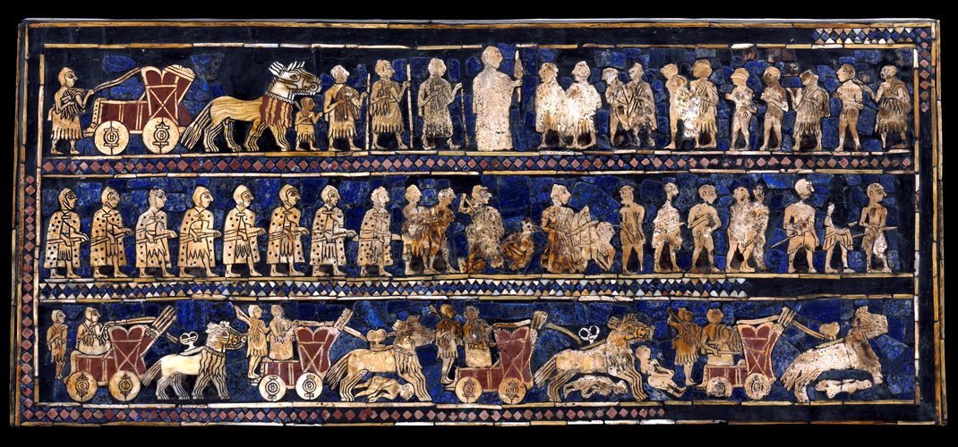
Art of Mesopotamia
The Standard of Ur: War Side Sumerian 2600 BCE
Notes:
The Standard of Ur is a wooden box covered with Lapis Luzuli and shell depicting a war scene on one side and a peace banquet on the other. The war side has the battle beginning in the bottom register and moving up until the prisoners of war are presented to the King who is center top and larger than the others (Hierarchy of Scale). They are in depicted in a stance called composite view because it shows profile and frontal view at the same time.
Observations: Man in center top register is larger than others Inferences: Hierarchy of scale means he is leader
Chariots in bottom register They are running people over, war
People bound at the hands They are prisoners of war
Soldiers
etc.

Slide 80
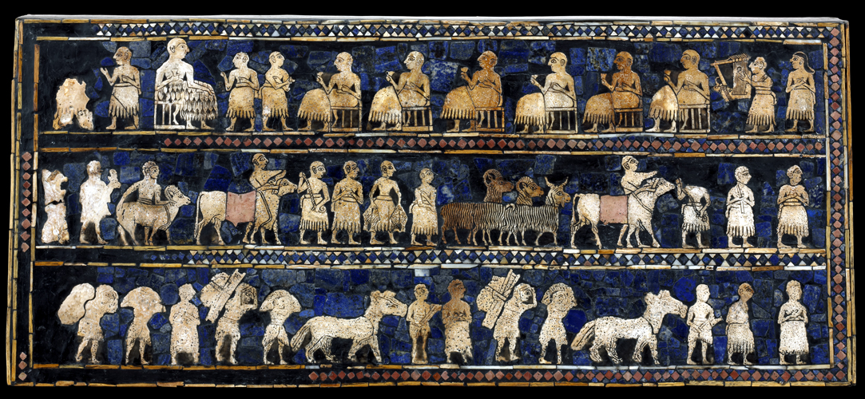
The Standard of Ur: Peace Side Sumerian 2600 BCE
Notes:
Observations: cows Inferences: had domesticated animals
Men carrying grain They had agricultural technology
Top register has man on far left larger He is the leader or king
Men in top register and drinking They are having a victory banquet
The lower two registers have people bringing offerings to the king, many of which can be assumed are spoils of war due to the war depicted on the other side.

Slide 81
8,000 BC
3,500 BC
3,000 BC
2,700 BC-
2,200 BC
2,200 BC
2,050 BC-
1,800BC
Agriculture begins
In various places
Cities develop
Along the Tigris-
Euphrates Rivers
• King Narmer
Unifies Egypt
Beginning of the
Old kingdom
Beginning of the
Middle kingdom
V. First Empire Builders
1. AKKAD 2350 B.C.E.
A. Sargon I, ruler of Akkad Sumerian city-states.
B. Conquered & united Mesopotamia under one empire
C. Akkadians & Sumerians adopted each other’s culture.
****Created World’s First Empire
Only lasted 140 years but laid foundation for future empires
Akkad
Notes:
From 3000 to 2000 B.C., the city-states of Sumer were almost constantly at war with one another. The weakened city-states could no longer ward off attacks from the peoples of the surrounding deserts and hills. Although the Sumerians never recovered from the attacks on their cities, their civilization did not die. Succeeding sets of rulers adapted the basic ideas of Sumerian culture to meet their own needs.
About 2350 B.C., a conqueror named Sargon defeated the city-states of Sumer. Sargon led his army from Akkad (AK•ad), a city-state north of Sumer. Sargon’s conquests helped to spread that culture even farther, beyond the Tigris-Euphrates Valley.
By taking control of both northern and southern Mesopotamia, Sargon created the world’s first empire. An empire brings together several peoples, nations, or previously independent states under the control of one ruler.
At its height, the Akkadian Empire loosely controlled land from the Mediterranean Coast in the west to present-day Iran in the east. Sargon’s dynasty lasted only about 200 years, after which it declined due to internal fighting, invasions, and a famine.

Slide 82
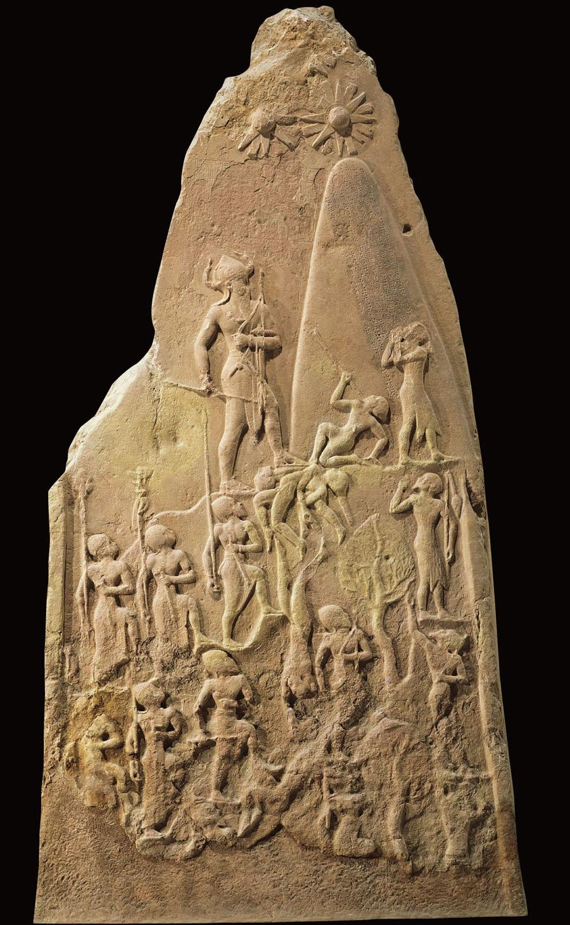
Victory Stele of Naram-Sin Akkadian 2300 BCE
Notes:
Victory stele of Naram-Sin is a relief depicting the conquest of Naram-Sin and the Akkadians against the Lullabi people in Iran. It would have been displayed to the public and is one of the earliest examples of propaganda. Depicts power and authority, religion, landscape, war, death and violence
Observations: Large man near top Inferences: He is Naram-Sin and the leader
Soldiers climbing the mountain The army of Naram-Sin
Man cowering before Naram-Sin Leader of opposing force and is accepting defeat
Men falling off the mountain Fallen soldiers of opposing force
Mountain
Stars at top represents dieties and shows that the victory was sanctioned by the gods

Slide 83
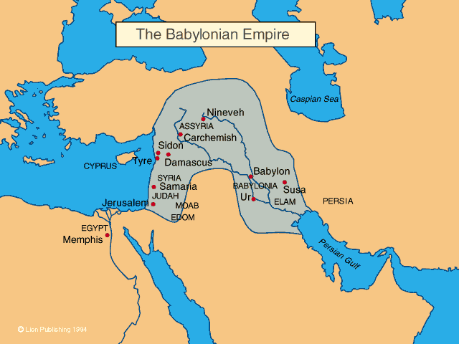
V. First Empire Builders
1. Babylonian Empire 1790 B.C.E
A. Hammurabi, King of Babylon conquered & united Mesopotamia
B. Biggest Achievement -
Hammurabi’s Code - 1st set of written laws in the world.
- assigned a specific punishment for each violation
C. Adopted elements from the previous societies such as the language and cuneiform writing
D. Honored the Sumerian Gods
E. Increased trade throughout the empire lead to vast wealth.
Notes:
Sargon I built the first empire known to history. His huge achievement did not last long, however. Soon after his death, other invaders invaded Mesopotamia, destroying his empire.
In time, the Sumerian city-states revived, and their power struggles resumed. Eventually, however, new conquerors came and unified Mesopotamia.
Babylonian Empire In about 2000 B.C., nomadic warriors known as Amorites invaded Mesopotamia. Gradually, the Amorites overwhelmed the Sumerians and established their capital at Babylon, on the Euphrates River. The Babylonian Empire reached its peak during the reign of Hammurabi, from 1792 B.C. to 1750 B.C. Hammurabi’s most enduring legacy is the code of laws he put together.
D. He wanted everyone in his empire to know the legal principles his government would follow. He had 282 laws carved on a stone pillar for all to see. On it he proclaimed that his goals were to "cause justice to prevail in the land/To destroy the wicked and evil/ That the strong may not oppress the weak."
- If any one bring an accusation of any crime before the elders, and does not prove what he has charged, he shall, if it be a capital offense charged, be put to death.
-If any one steal cattle or sheep, or an ass, or a pig or a goat, if it belong to a god or to the court, the thief shall pay thirtyfold; if they belonged to a freed man of the king he shall pay tenfold; if the thief has nothing with which to pay he shall be put to death.

Slide 84
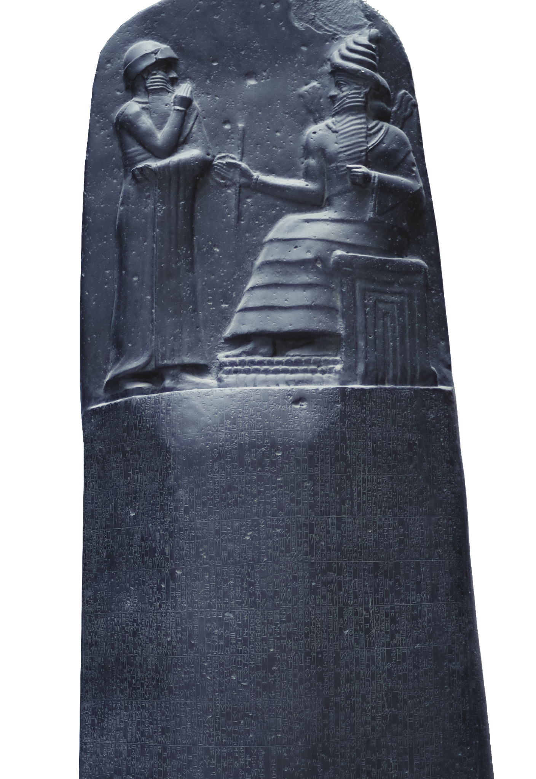
Law Code of Hammurabi, Babylonian 1754 BCE
FAST FACT! ”An eye for an eye ..." is a paraphrase of Hammurabi's Code. The code was found by an archaeologists in 1901 while excavating in modern-day Iran.

Slide 85
Write a Thesis
Choose one of the artworks we have viewed so far and write a thesis statement discussing how it demonstrates the characteristics of a civilization.

Slide 86
Notes Summary

Slide 87
Day 4

Slide 88
WARM-UP
What is the objective of punishment? Is punishment the purpose in itself? Is the purpose to deter people from committing crime by making them scared? Is the purpose to rehabilitate people so they are productive, contributing members of society when they are done?

Slide 89
Hammurabi’s Code
1700s BCE

Slide 90
Evaluation of Evidence
We must evaluate all evidence
To evaluate evidence, we ask:
Why is a document useful?
What are its limitations?
What other information do we need?

Slide 91
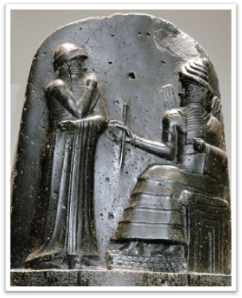
Who was Hammurabi?
Member of the Amorite dynasty
King of Babylon from 1792-1750 BCE
United all of Mesopotamia under the Babylonian Empire
Relief of Hammurabi and the god Shamash

Slide 92
Hammurabi’s Code
Laws for Babylonian society
Tool to unify expanding empire
“That the strong might not injure the weak”
Allowed everyone to know the rules

Slide 93
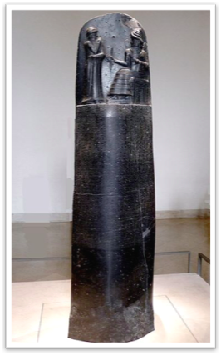
What does it look like?

Slide 94
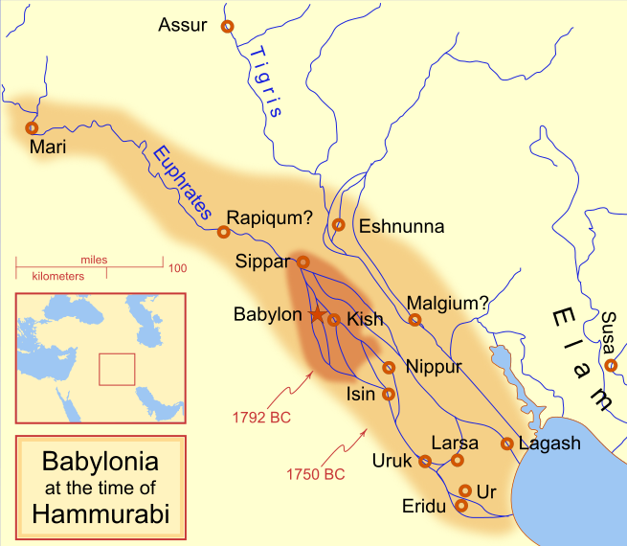
Loss and Unearthing

Slide 95
Central Historical Question
What can we learn about Babylonia from Hammurabi’s Code?

Slide 96
Notes:
Model historical reading skills
Walk students through all documents
Discuss answers

Slide 97
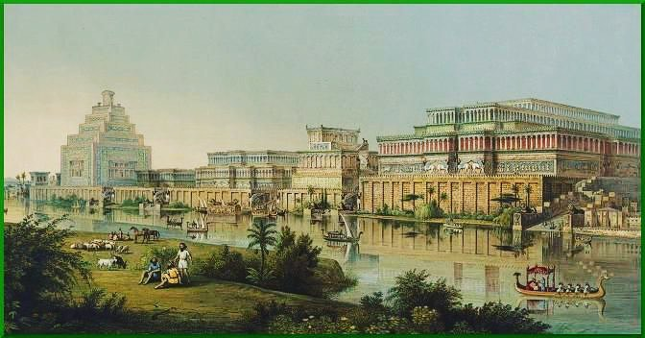
ASSYRIA

Slide 98
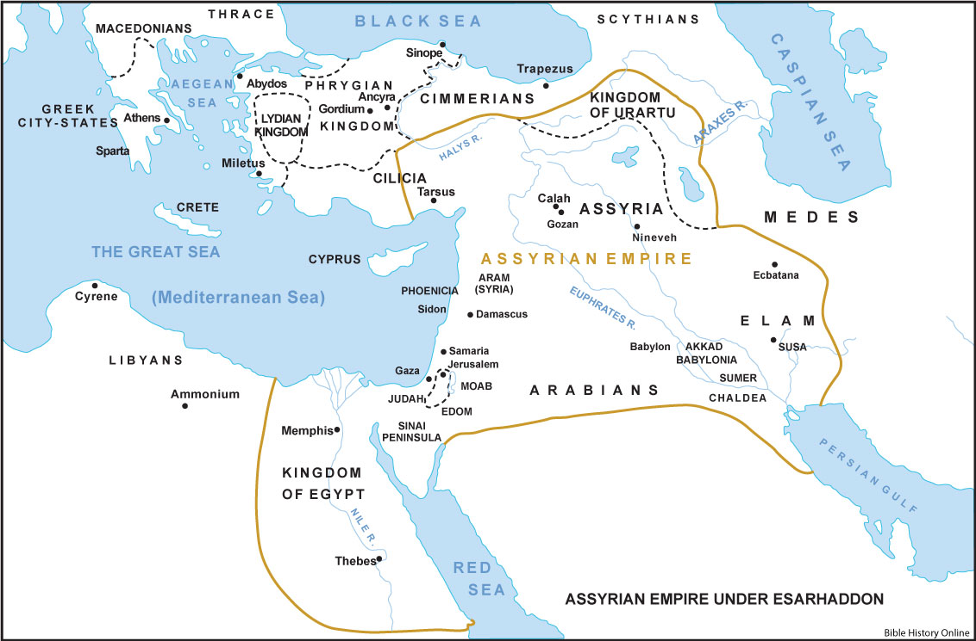
Assyrian Empire
1st Rise: Shortly after the fall of the Akkadians (roughly 2155 b.c.)
2nd Rise:1360-1074
3rd Rise (Neo-Assyrian): 911-612 b.c.

Slide 99
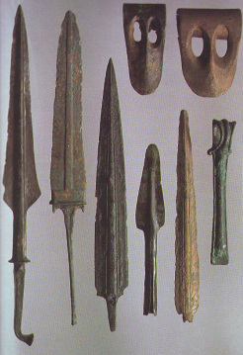
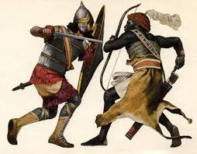
The Iron Age
The Assyrians were the first civilization to use iron for weaponry including swords, spears, and arrows.
In addition to weapons, Assyrians used iron to plate their shields, to make their armour, and for their battering rams.
In addition to weapons, Assyrians used iron to plate their shields, to make their armour, and for their battering rams.

Slide 100
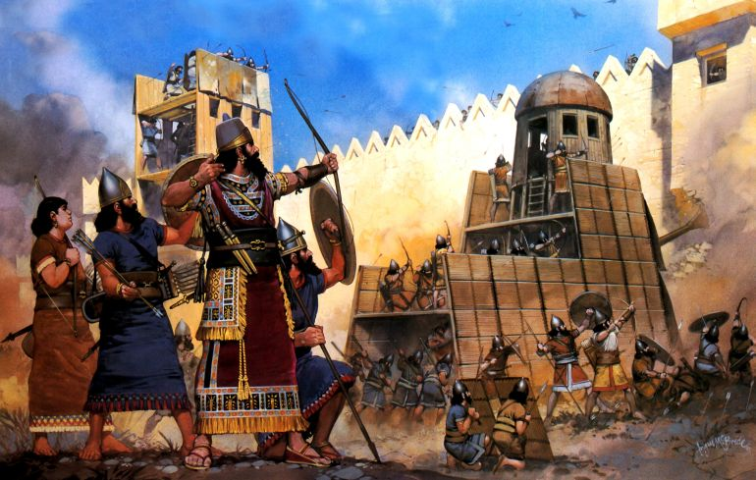
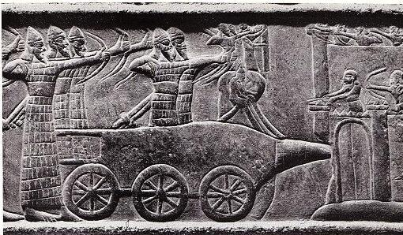
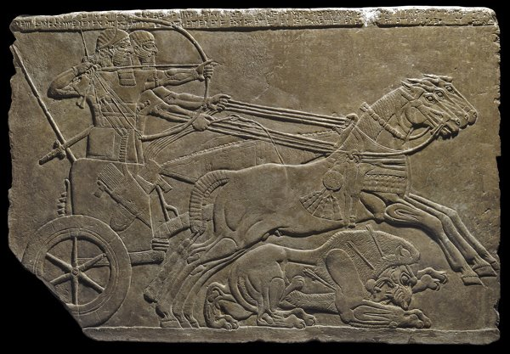
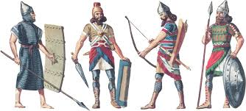
Warfare
Notes:
In addition to weapons, Assyrians used iron to plate their shields, to make their armour, and for their battering rams.
This pictures depicts

Slide 101
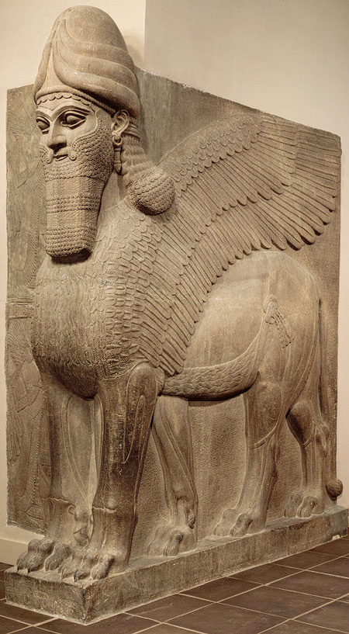
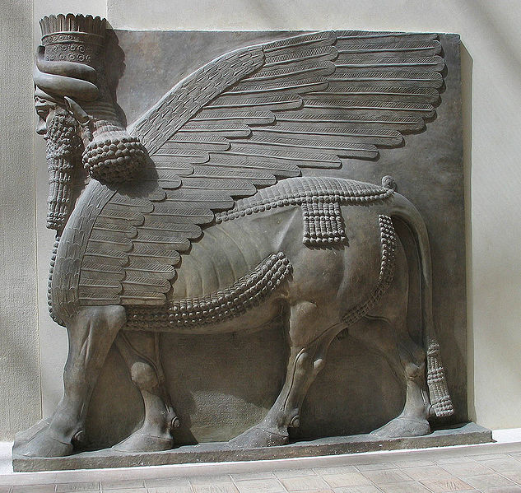
Lamassu Assyrian 720 BCE
Notes:
Lamassu is a winged, human-headed bull that guards the gate to Assyrian palaces. They are composite creatures who are said to the holy guardians of the king. They have 5 legs so that when looking from side you can see all four legs giving the appearance of movement but front on they stand still like a sentry
Observations: Clawed or hooved feet Inferences: create a monster to intimidate visitors and demonstrate
A man’s head kings power
Wings
Bull or lion body

Slide 102
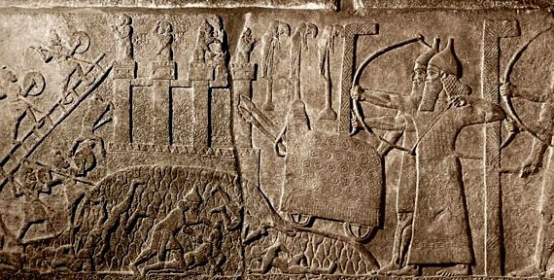
Wall Relief from Palace of Nimrud, Assyrian
Notes:
This wall relief depicts the Assyrian army conquering a city. You can see archers in the right forefront, soldiers climbing ladders and taking the city wall. Its hard to see but in the bottom front there are enemy people being stabbed by an Assyrian soldier. The Assyrians are identifiable by their pointed hat. The relief is a low relief image with the figures in composite view.
Observations: Inferences:
Men with bow and arrows on right This is a war scene with one army attacking another
men climbing a ladder They are climbing a wall to a city to conquer it
men on wall

Slide 104
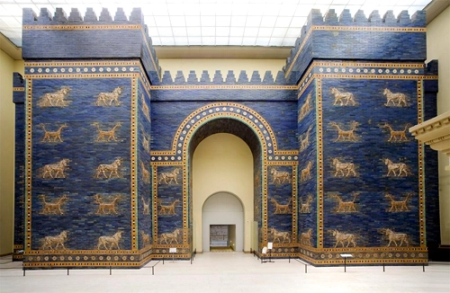
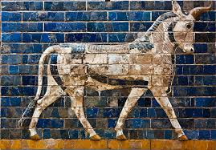
Ishtar Gate Neo-Babylonians 575 BCE
Notes:
Ishtar Gate is the main gate into the city of Babylon. This gate would have held one of Babylon’s wonders of the world the Hanging Gardens of Babylon. Has Lions, Bulls, and Dragons depicted on the walls of the gate. The Lions are the god Ishtar’s sacred animals. The Dragon and Bull were guardians to the Gods. The crenelations on the top of the gates would have allowed for easy defense of the gate.
Observations: Lions, Dragons, Bulls Inferences: guardian animals of the city, sacred to the gods, represents the gods

Slide 105
Notes Summary

Slide 106
Day 5

Slide 107
The Great Pyramid is believed to have been built over a 20 year period.
Assumptions:
• The Great Pyramid in Egypt has exactly 2 million (2,000,000) stones.
• Assume each stone weighs 2.5 tons.
• Assume we are talking about a short ton or net ton which weighs 2000
pounds.
Questions
1. In pounds how much does the Great Pyramid weigh?
2. Assuming the workers worked a five day week and worked 50 out of the 52 weeks each year, How many stones did they set each day.
2.5 x 2000 = 5000 lbs 5000 x 2,000,000 = 10,000,000,000
20 years x 50 weeks x 5 days = 5000 days
2,000,0000 stones divided by 5000 = 400 stones per day
Notes:
Day 3 – Incorporating Math into the curriculum
1. In pounds how much does the Great Pyramid weigh?
2.5 x 2000 = 5000 lbs 5000 x 2,000,000 = 10,000,000,000
2. Assuming the workers worked a five day week and worked 50 out of the 52 weeks
each year, How many stones did they set each day.
---20 years x 50 weeks x 5 days = 5000 days
---2,000,0000 stones dived by 5000 = 400 stones per day

Slide 108
Pre-quiz 2
What are some technological advancements of Egypt
What do you know about Egyptian writing systems?
Who makes up the Egyptian social system?
How did cities start to take form?

Slide 109
Dig Site: Ancient Egypt

Slide 110
Artifact 16--Egypt

Slide 111
Artifact 16--Mummification tools
(brain hooks, oil jar, funnel, and embalmer’s knife)
Egyptians believed that all people had souls, which they referred to as ‘ka.’ The ka was a person's double, sort of an invisible twin, which supposedly lived in the body until death. It was necessary to prevent the dead body from decaying because the ka still needed it! This is why the Egyptians wanted to preserve the dead in as life-like a state as possible. Mummification was the guarantee of eternal life.
The entire process of mummification took 70 days to complete. Several well-respected embalmers conducted the task. The chief embalmer wore a jackal mask to represent Anubis, the god of mummification. Assistants bandaged the body and carried out other tasks of the embalming process.
After being delivered to the embalming place, the deceased was placed upon a slanted table. The first task that needed to be done was to remove the soft, moist body parts that would cause decay. As these parts were removed, blood and other bodily fluids trickled out and flowed down the table into a collecting bowl.
The first part to be removed from a mummy was the brain. The bone that separates the nasal cavity from the brain cavity was broken open by ramming a sharp instrument up the nose. Then, a long hook was used to stir up the brain until it was liquefied. By turning the body face down, the brain would spill out the nostrils. The Egyptians were so rough on the brain because they didn't realize its importance. They thought its purpose was just to produce snot!

Slide 112
Artifact 17--Egypt

Slide 113
Artifact 17—Canopic Jars
After the brains had been removed from the potential mummy, the next step was to remove some of the major organs. One of the embalmers would use a blade made of sharpened stone to make an incision in the left side of the abdomen.
Although cutting into the corpse’s side was entirely necessary to remove the organs, the embalmers didn't like it because it was considered sinful to "injure" a corpse. In mock ceremony, the other embalmers present would curse and throw stones at the man who made the cut. They didn't really try to hurt him, it was all just part of the ceremony.
The stomach, intestines, liver, and lungs were removed and preserved by drying them in a special salt called natron. After drying, each of the organs would be put in a canopic jar. The stoppers of canopic jars were shaped like the heads of the four sons of the god Horus. Each son protected the organ placed inside his respective jar. These jars would be placed inside the tomb upon the burial of the mummy.

Slide 114
Artifact 18--Egypt

Slide 115
Artifact 18—Sistrum
A sistrum was basically a rattle made up of an arch with a handle attached. The arch had a number of cross pieces onto which were threaded metal discs. When the sistrum was shaken, the discs rattled. The top of the handle was often decorated with the head of the god of music, Hathor.
This instrument, which is shown being carried by figures in tomb and temple scenes, indicated devotion to Hathor. The sistrum had a shape very similar to an Egyptian symbol called the ankh ( ), which symbolized eternal life. As a result of this similarity, the sistrum also began to represent eternal life.
The sistrum was used in Egyptian festivals and was often played by temple songstresses. It was believed that the sound of rattling also drove off malign forces, preventing them from spoiling the festival.

Slide 116
Artifact 19--Egypt

Slide 117
Artifact 19—Crocodile Skin Armor and Helmet
In ancient Egypt the crocodile was seen as sacred and divine, and worshipped as a god, so this suit might have been worn by priests of the crocodile sect who by wearing such a garment would take on the spirit of the deity. In many parts of Africa the crocodile is seen as a fearsome and invincible creature and so, by wearing crocodile armor and a headpiece like this, a warrior might be transformed in some magical way and take on the attributes of the animal.
This imposing armor is made from the skin of a crocodile. It is made up of a helmet and cuirass (body armor) and would have been used in military-style ceremonies of the regional crocodile cult.

Slide 118
Artifact 20--Egypt

Slide 119
Artifact 20—Egyptian ‘Pillow’
This folding headrest is modeled on the folding stools that were popular among the wealthy of the time. A rivet through the center of the legs allowed it to fold shut, while the neck piece of the headrest secured it in the open position. The wooden runners made the headrest stable when it was in use. Egyptians would have used this headrest in much the same way that modern Americans use soft pillows.
The lower ends of the legs are carved in the shape of ducks, a motif often used in furniture items. On this headrest, heads of the god Bes are carved onto the neckpiece. Bes, the god of the home, frequently appeared on household items. Night was a time when people felt that they were vulnerable to evil forces; demons could cause illness and nightmares, attacking while the unsuspecting person slept. Figures or heads of Bes were sometimes placed on headrests to ward off these chaotic forces.

Slide 120
ANCIENT EGYPT
AND THE NILE VALLEY

Slide 121
I. EGYPTIAN RIVER VALLEY
Africa
Notes:
The Nile River is the world’s longest River - about 4,160 miles long.
It begins in the south. The Nile receives it water from heavy tropical rains In the south as well as melting Mountain snow in East Africa. So in the Spring the Nile floods its banks and doesn’t recede until late fall.

Slide 122
I. EGYPTIAN RIVER VALLEY
Lower Egypt
Delta
Triangular area of marshland formed by deposits of silt at the mouth of some rivers
Upper Egypt
AFRICA
Notes:
If we take a closer look, we can see that the Nile is surrounded by desert. There really isn’t a lot of fertile land, But what happens in the spring? It floods and now all land by the Nile is flooded with water. When it recedes in the fall, it leaves behind a thick deposit of silt, perfect for farming.
At the mouth of the Nile(one of the very few rivers in the world to flow North) you can see the Delta - This is the triangular area of marshland formed by deposits of silt at the mouth of some rivers.
Again it is surrounded by desert. To what advantage does any civilization living there have because of the surrounding desert? . . Protected from foreign invasion.
Uniting- And so now we have small settlements that dot all over this Nile valley. Eventually these small segments became united into several kingdoms. Again weaker kingdoms would give way to larger ones until by 4000 B.C, ancient Egypt consisted of two large kingdoms: Lower Egypt in the North In the Nile Delta and Upper Egypt in the South, in the Nile Valley.
---- Lower Egypt covered the delta region. What's a delta? . . . a triangular area of marshland formed by deposit of silt at the outh of some rivers.

Slide 123
4,400,000 BC
100,000 BC
8,000 BC
3,500 BC
3,000 BC
Earliest Known human
ancestor Lives in Africa
Neanderthals spread
from Africa Into Europe
and Asia
Agriculture begins
In various places
Cities develop
Along the Tigris-
Euphrates Rivers
• King Menses
Unifies Egypt
A. Little rainfall - thus they relied on the Nile’s yearly floods for water & silt.
Memphis •
B. King Menes(Narmer) of Upper Egypt conquered Lower Egypt, uniting Egypt as one.
- Memphis - Capital
Egypt
C. Ruling dynasties organized into 3 periods:
1. Old Kingdom,
2. Middle Kingdom,
3. New Kingdom.
Notes:
Nile Each July, the Nile would begin to Flood. At the end of October, the flood began to recede, leaving behind a deposit of silt as well as lagoons and streams that became reservoirs for fish. By April, the Nile was at its lowest level. Vegetation started to diminish, seasonal pools dried out, and game began to move south. Then in July, the Nile would rise again, and the cycle was repeated.
What's silt? Soil - to control the flood, people had to work together to create dams, dikes, & irrigation ditches.
Around 5,000 B.C. nomadic hunter Gatherers of Northeastern Africa began settling by the Nile. They take up farming regulated by the Nile’s seasonal rise and fall, growing cereal crops such as wheat and barley. They become secluded surrounded by the deserts to the east and west.
Narmer/Menes
By 3200 B.C., the villages of Egypt were under the rule of two separate kingdoms, Lower Egypt and Upper Egypt. Eventually the two kingdoms were united. There is conflicting historical evidence over who united Upper and Lower Egypt.
C. What is a dynasty? It’s a succession of rulers from the same family.

Slide 124
8,000 BC
3,500 BC
2,700 BC-
2,200 BC
2,200 BC
2,050 BC-
1,800BC
3,000 BC
Agriculture begins
In various places
Cities develop
Along the Tigris-
Euphrates Rivers
• King Menses
Unifies Egypt
Beginning of the
Old kingdom
Beginning of the
Middle kingdom
II.The Old Kingdom 2700 B.C. to 2200 B.C (In Green)
A. Theocracy - Govt where the religious leader is the political leader
Pharaoh - God King
B. Bureaucracy - Govt where most decisions are made by govt officials rather than King
C. Vizier controlled trade, tax collection, & building of infrastructure.
Notes:
To the Egyptians, kings were gods. The Egyptian god-kings, called pharaohs, were thought to be almost as splendid and powerful as the gods of the heavens. This type of government in which rule is based on religious authority is called a theocracy.
Theocracies are when the same person serves as both the religious leader and the political leader. Egyptians regarded their leader as a God. It’s as if the president of the United States was also the Pope.
Vizier is a chief minister that supervises the business of government. They supervised the business of government including taxes, farming irrigations systems.
Egyptians believed that a king’s soul continued to guide the kingdom after death before entombing the king, the preserved the King’s body from decay by a procedure called embalming - mummy.

Slide 125
8,000 BC
3,500 BC
2,700 BC-
2,200 BC
2,200 BC
2,050 BC-
1,800BC
3,000 BC
Agriculture begins
In various places
Cities develop
Along the Tigris-
Euphrates Rivers
• King Menses
Unifies Egypt
Beginning of the
Old kingdom
Beginning of the
Middle kingdom
D. Pyramids - Tombs that honored their god-kings & give them an eternal place of rest.
Notes:
During the Old Kingdom, the Egyptians built the pyramids that still stand at Giza today. The pyramids were tombs for eternity. Because Egyptians believed in an after- life, they preserved the bodies of their dead rulers and provided them with everything they would need in their new lives.
To complete the pyramids, workers hauled and lifted millions of limestone blocks, some weighing two tons or more. The builders had no iron tools or wheeled vehicles. Workers quarried the stones by hand, pulled them on sleds to the site, and hoisted them up earthen ramps. Building a pyramid took so long that often a pharaoh would begin to build his tomb as soon as he inherited the throne.
The pyramids suggest the strength of ancient Egyptian civilization. These expensive projects required enormous planning and organization. Thousands of farmers, who had to be fed each day, worked on the pyramids when not planting or harvesting crops.
When finished, the pyramid was coated with limestone and topped with a gold capstone.

Slide 126
II. THE MIDDLE KINGDOM 2200 B.C. to 1800 B.C
a. Egypt conquered by the Hyksos.
- ruled Egypt for 110 years
- Introduced Chariots & Bronze weapons to Egypt
Notes:
^ Around 2,200 B.C. the kings in Memphis began losing their power. Egypt began fighting with itself for power. There were also crop failures, and the cost of the pyramids also contributed to it's collapse. Finally a new dynasty reunited the kingdom. They conquered new land Egypt, including Syria. This marks the beginning of the Middle Kingdom.
The Hyksos invaded Northern Egypt (the delta region). They had a couple secret weapons that the Egyptians had never even seen before. They were horse drawn chariots and Bronze weapons. For over a hundred years, they ruled over the Egyptians.
- - This only made the Egyptians stronger. Their civilization learned from their captures how to make bronze weapons and chariots. What do we call that? Cultural diffusion

Slide 127
3,500 BC
3,000 BC
2,700 BC-
2,200 BC
2,050 BC-
1,800BC
1,800 BC
1,600 BC
8,000 BC
Cities develop
Along the Tigris-
Euphrates Rivers
• King Narmer
Unifies Egypt
Beginning of the
Old kingdom
Beginning of the
Middle kingdom
Beginning of the
New kingdom
III. THE NEW KINGDOM
A. Queen Hatshepsut came to power
- Extensively built Egypt.
- Egypt's Empire grows to it's
largest height.
https://www.youtube.com/watch?v=8bYRy_wZEJI
B. Ramses II - Egypt's most powerful pharaoh
- signed the first known peace treaty w/Hittites.
https://www.youtube.com/watch?v=axttkV4Gs8c
Queen Hatshepsut Before
After
Notes:
Finally in 1600 BC, an Egyptian Prince named, Ahmosuh lead a rebellion against the Hyksos and drove them out. This marks the beginning of the New Kingdom.
During the New Kingdom, powerful and ambitious pharaohs created a large empire. At its height, the Egyptian empire reached the Euphrates River. This age of conquest brought Egypt into greater contact with south-western Asia as well as with other parts of Africa.
The Pharaohs
Ahmousuh becomes the new pharaoh. Hatsheptsut first ruled with her husband and when he died, she crowned herself pharaoh.
as the empire grew from the conquered territories, it also benefited from cultural diffusion.
Picture of Hatsheptsut Before - Click. Picture of Hatshepsut after
Ramses II, who ruled during the 1200s B.C., pushed Egyptian rule northward as far as Syria. He erected large statues of himself and built many temples and monuments. His wars was with the Hittites and finally I brokered the first know peace treaty in the world with them. He declared It declared that Egypt and the Hittites “shall be at peace and in brotherhood forever.”
Ramses had 200 wives and hundreds children.
NEXT Slide
Decline. After Ramses II, Egyptian power slowly declined. Invaders, such as the Assyrians and Persians, conquered the Nile region. Later, Greek and Roman armies came from the north. Egypt was valuable to the empires. Egypt’s fertile Nile Valley was fertile and could provide crops and food for their empires.

Slide 128
III. THE NEW KINGDOM
A. Nubians - rivals from the south conquered the Egypt (750 B.C.)
Nubians adopted much of Egyptian Culture
- Followed by the Assyrians, Persians, Greeks & the Roman Empire
Notes:
Decline. After Ramses II, Egyptian power slowly declined. Invaders, such as the Assyrians and Persians, conquered the Nile region. Later, Greek and Roman armies came from the north. Egypt was valuable to the empires. Egypt’s fertile Nile Valley was fertile and could provide crops and food for their empires.

Slide 129
Egyptian Inventions
Papyrus paper
Eye Makeup
Simple machines (ramps, pulleys)
Sails, ships
365 day calendar and leap year
Decimal system
Engineering feats (Pyramids, temples, monuments, lighthouse)

Slide 136
Archeological Dig!
In groups creating and discovering artifacts from ancient civilization
Assyria
Akkadian
Chaldeans/ Neo-Babylon
Egypt
Phoenicians
Sumer
Create the following artifacts. Write an explanation on the back. Color!
Map of Location
Sample of Writing
Name and depiction of most prominent leader
Artifacts from the following classes:
Royalty
Priest
Merchant
Artisan
Farmer/ Peasant
Cut up and place in your archeological plot

Slide 137
Notes Summary

Slide 138
DAY 6

Slide 139
Starter
What can artifacts teach us about a society? What limitations do artifacts have for teaching us about history?

Slide 140
Archeological Dig!
In groups creating and discovering artifacts from ancient civilization
Assyria
Akkadian
Chaldeans/ Neo-Babylon
Egypt
Phoenicians
Sumer
Create the following artifacts. Write an explanation on the back. Color!
Map of Location
Sample of Writing
Name and depiction of most prominent leader
Artifacts from the following classes:
Royalty
Priest
Merchant
Artisan
Farmer/ Peasant
Cut up and place in your archeological plot

Slide 141
Archeological Dig!
Switch archeological plots
Put artifacts back together
Learn from artifacts and prepare to present about civilization
Present!

Slide 142
Notes Summary

Slide 143
Day 7

Slide 144
Starter
What is one interesting thing you learned from your research last class?

Slide 145
Picking the right search terms
Beginner Lesson 1
Created by:
Tasha Bergson-Michelson
Kathy Glass

Slide 146
What food does Tyson like best?
Notes:
Tell students they will be introduced to seven advanced operators to use in their searches.

Slide 148
What food does Tyson like best?

Slide 154
[cow blister tongue sick]
or
[cattle blister tongue sick]

Slide 155
[professional toss pizza]

Slide 156
[ghost town San Francisco Bay]

Slide 158
What Matters In My Search Query?

Slide 171
Egypt Mythology and Religion Posters
Spend 40 Minutes researching and creating poster
Poster Presentation
Religious Rituals
Death Rituals
Afterlife story, Book of the Dead
Pharaohs and religion
Creation myth
Choose your own story on Gods/Goddesses

Slide 172
Notes Summary

Slide 173
Day 8

Slide 174
Warm Up (Ungraded Quiz)
What period were the Pyramids built?
Who conquered the Egyptians during the Middle Kingdom?
What good came out of it?
What Egyptian Pharaoh signed the first recorded peace treaty?
What is the job of a vizier?

Slide 175
What do you know about the Egyptian pyramids?

Slide 176
The Egyptian Pyramids

Slide 177
The Pyramids
The Pyramids at Giza

Slide 178
How were the pyramids built?
The Pyramids at Giza
http://www.history.com/topics/ancient-history/the-egyptian-pyramids/videos

Slide 179
Who built the pyramids?
The Great Pyramid at Giza

Slide 180
Central Historical Question
Did slaves build the Great Pyramid at Giza?

Slide 181
https://www.youtube.com/watch?v=lotbZQ55SgU

Slide 182
Review Assignment
 | 2.
3. | 4.
Neolithic Revolution. Think of how it changed the world for good and bad
Mesopotamia
Egypt
Split into groups. Each group creates a summary from their notes on their subject. They will write their summary into one quarter of a page. Use the back if you need to. Be sure to get the best information possible into your summary! When I tell you you will create new groups and share your information with each other. Teach it to each other. This helps you learn.

